Slide 1
Model Coproduction
Working with partners in your supply chain to agree the scope and content of delivery
Coproducing models to reduce gaps in client and supplier understanding
Matt Thomas
Paul Lynham

Slide 2
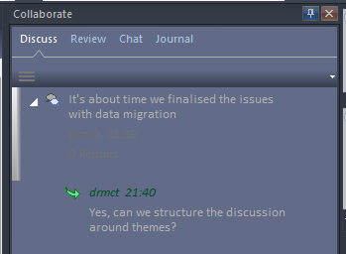
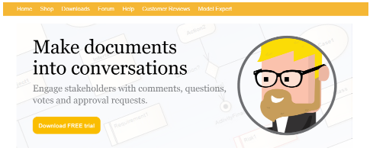
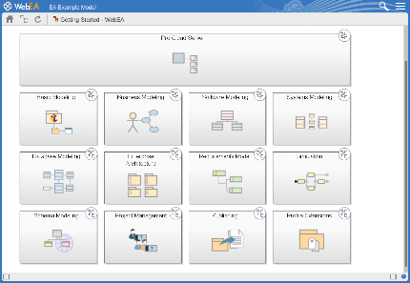
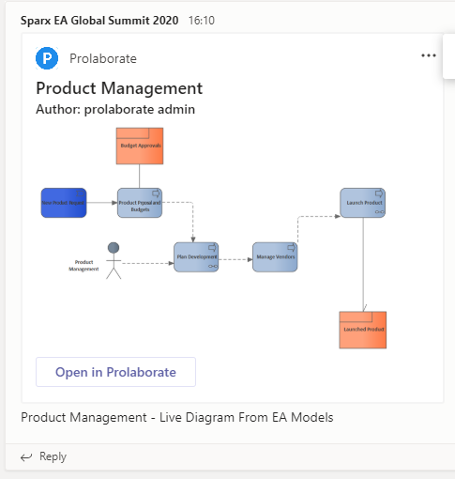
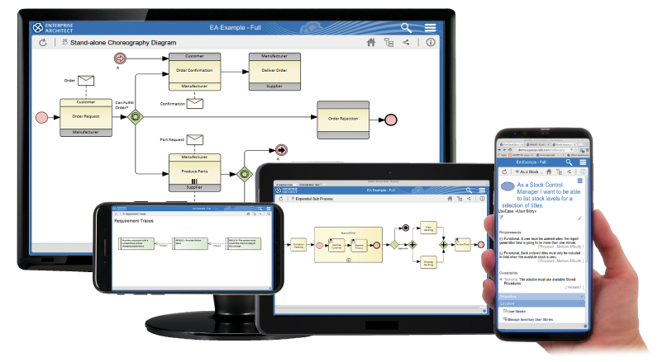
Sparx ecosystem collaboration tools
For modellers
Sitting together in front of a model – pair architecting
Using EA discussions, reviews, and model mail
For non-modellers
Curated documents
Generate documents from EA
eaDocX Collaboration Edition
Live view of models
ProCloud Server (and WebEA)
Prolaborate
Teams and Confluence integration

Slide 3
Collaboration approaches
 | Informal | Formally Document | Model Driven
EXAMPLES | Face-to-face, phone & video conferencing e.g. meeting, Skype, Zoom and Teams | Office suites like Microsoft Word, Teams, SharePoint | Modelling in Enterprise Architect, TOGAF®
FOR WHEN YOU WANT | To understand whom you’re dealing with | To record a mutual understanding of what you’re dealing with | Fully assured mutual understanding
FLAVOUR | The irreplaceable human touch | Familiar, improving, but still turgid and messy | Getting to grips with managing complex change programmes

Slide 4
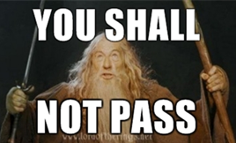
Model Coproduction: what magic is this?
Allow the fellowship into your mines
But protect my precious artefacts

Slide 5
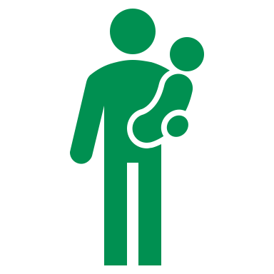
Cultural enruption

Slide 6
Convene
Goals
What is it?
How can I do it?
Motivation
Demo
Set up coproduction
First steps in Prolaborate
Prolaborate review
Harvesting outcomes
Architecture state modelling
Prerequisites
What benefits?
Reflect
Summary
Discuss

Slide 7
What is Model Coproduction?
“Built on the principle that those who are affected by a service are best placed to help design it”
From the social care industry, 1970’s, arose collaborative care.
As a client organisation
AND
As a supplier organisation
… of complex products and services requiring agreement about the requirements and design
Model Coproduction A new modelling term:
“Modelling together with your supply chain and user base.”
… we want a way of working together to reach collective outcomes

Slide 8
Coproduction Benefits
Build together to reduce gaps in understanding
Increase in quality
Get there sooner
Greater commitment from all parties
Linus’s Law
“Given enough eyeballs,
all bugs are shallow”
Eric S Raymond, ”The Cathedral and the Bazaar” ; - in honour of Linus Torvolds

Slide 10
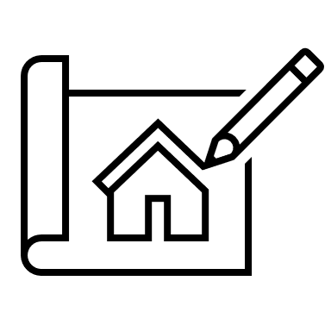
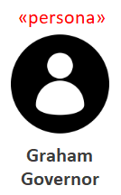
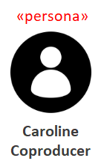
Upload candidate architecture to Coproduction Workspace
?
Bring approved target architecture increment into Architecture Repository

Slide 11
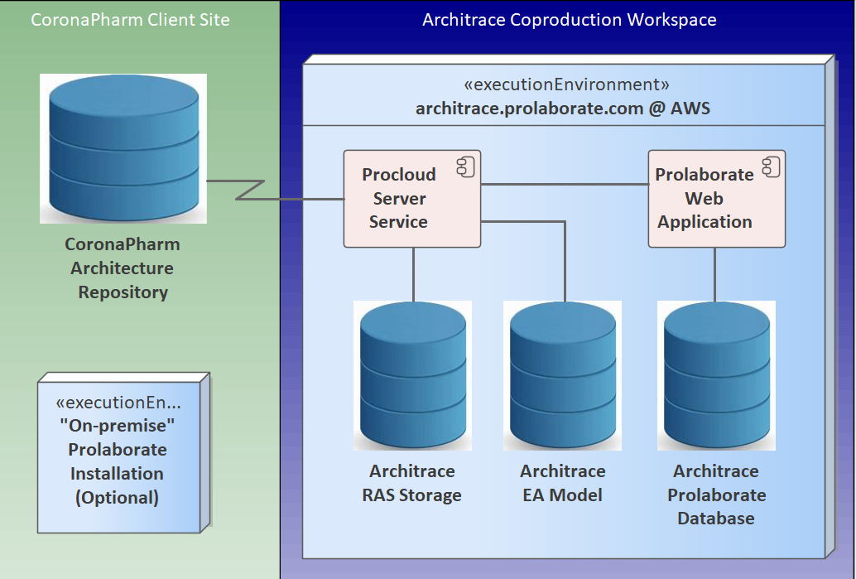
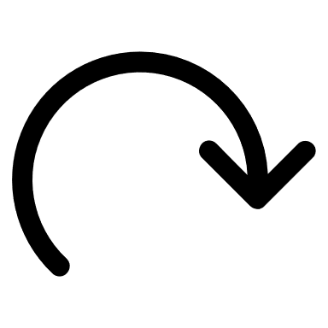
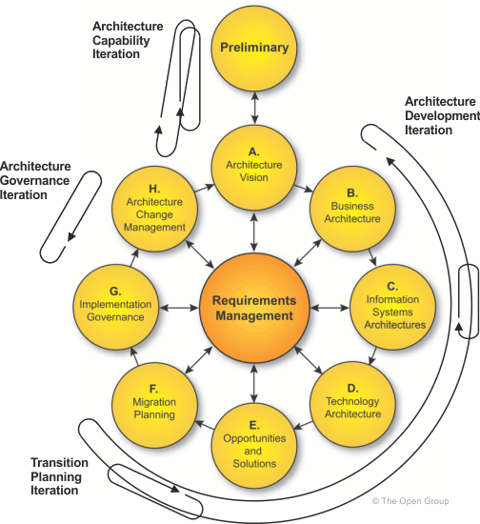
Coproduction Storyboard
Project brief
Register in RAS
Import from RAS
Openly architect
Refine in EA
Roundtrip to RAS
Harvest & analyse
Rinse & repeat
More “CONCRETE”
ABB Library
More “fluid”

Slide 12
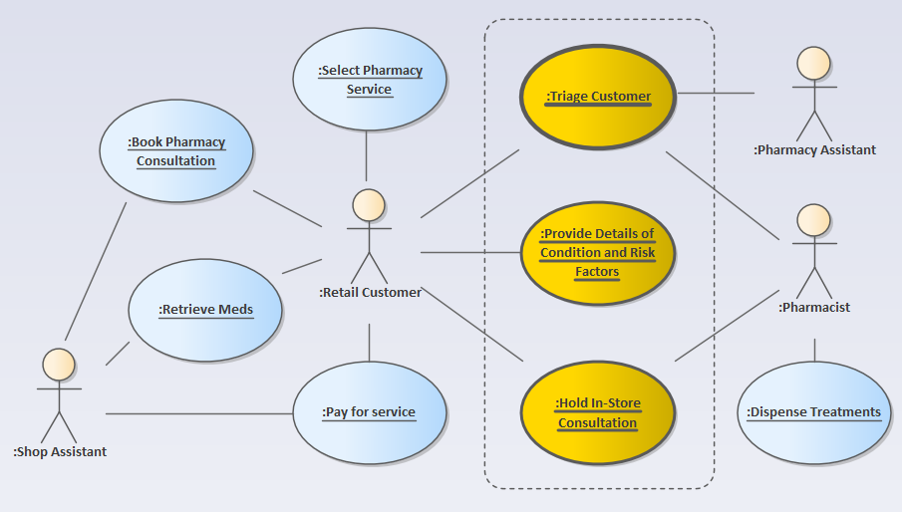
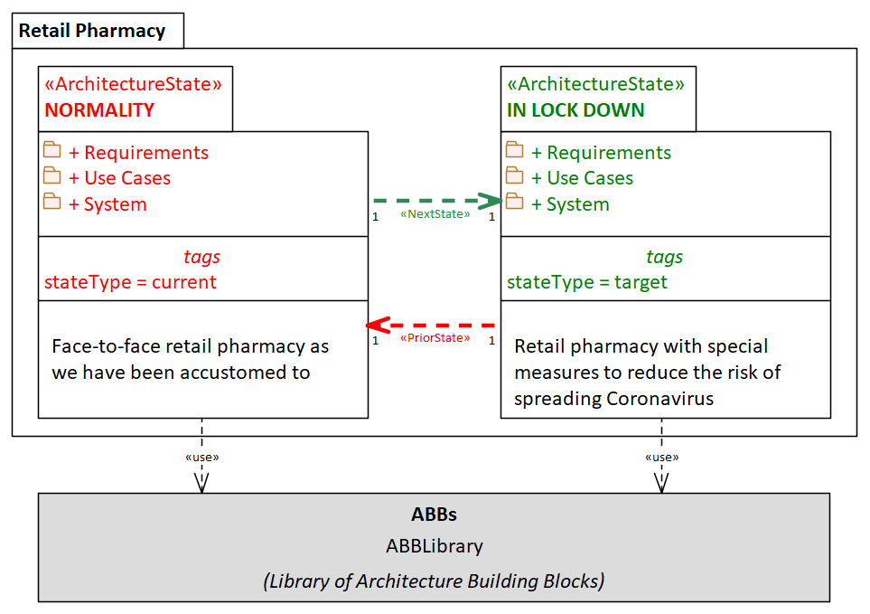
Example scenario
Global retail pharmacy brand, transforming their high-street consultation services for the Pandemic lock-down.
The challenge:
Multiple stakeholders in lock-down, needing to quickly agree the new service
New service requirements & design
Possible IT systems integration requirements

Slide 13
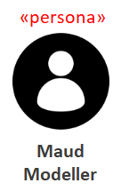
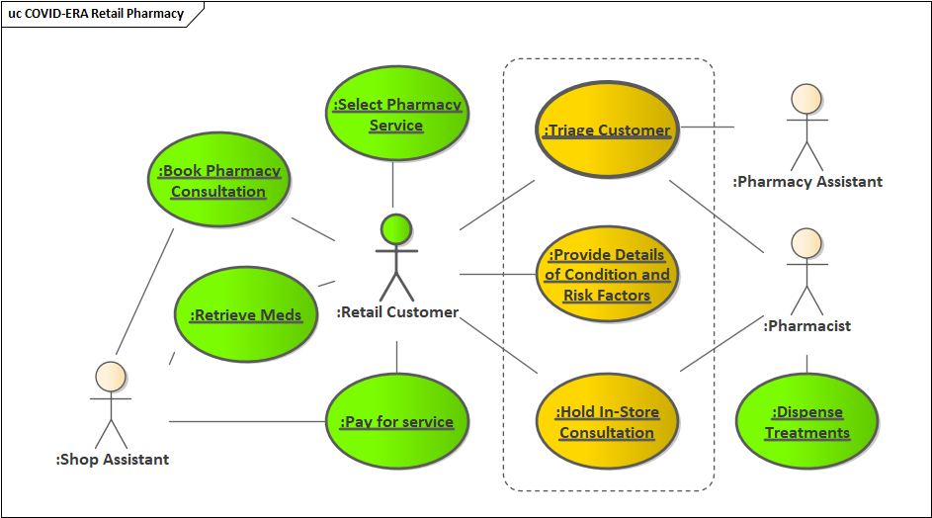
Request for architecture work

Slide 14
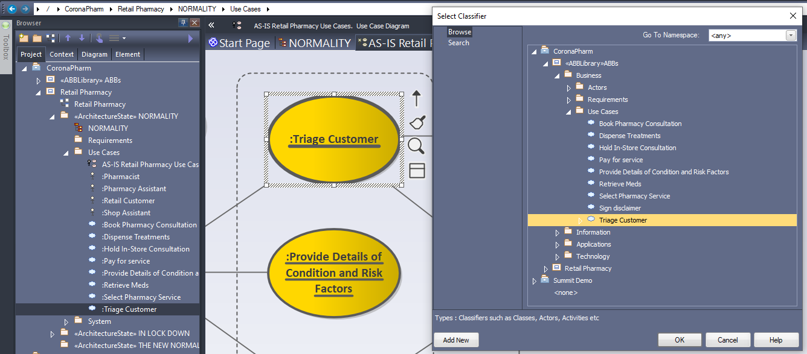
Initial candidate (foundations)

Slide 15
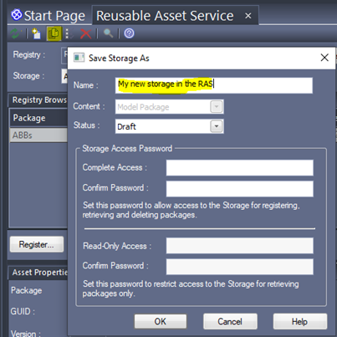
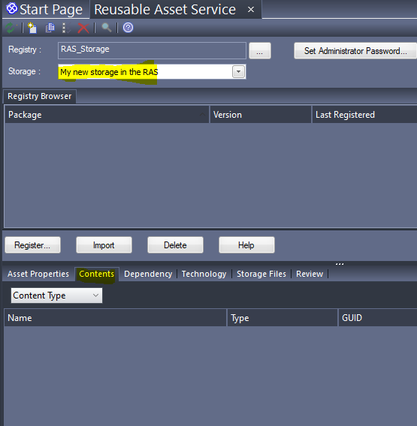
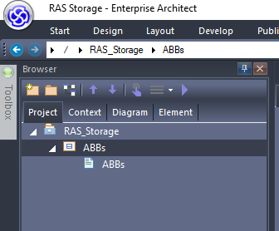
Register in the what?
Publish -> Reusable Assets ->

Slide 16
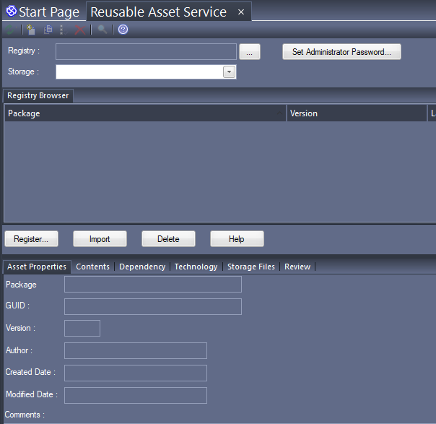
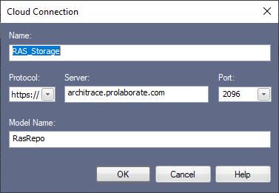
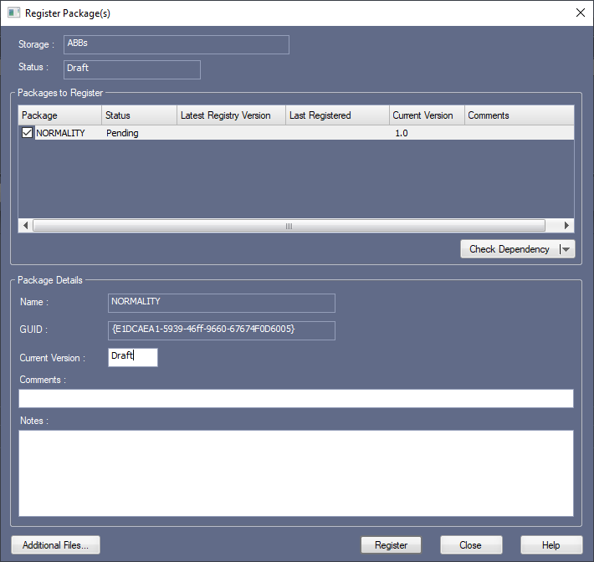
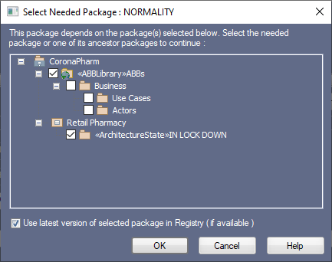
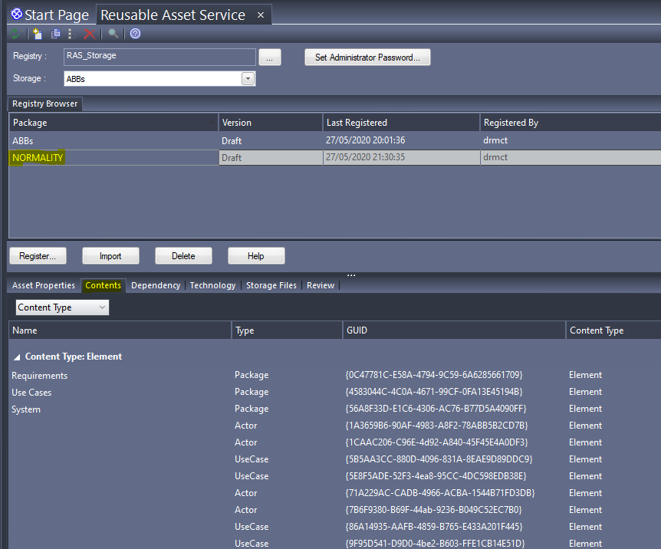
Register in the RAS
In CoronaPharm’s repository
Select the package to register
Connect to RAS: Publish -> Reusable Assets -> […]
Register the package: include ABBs

Slide 17
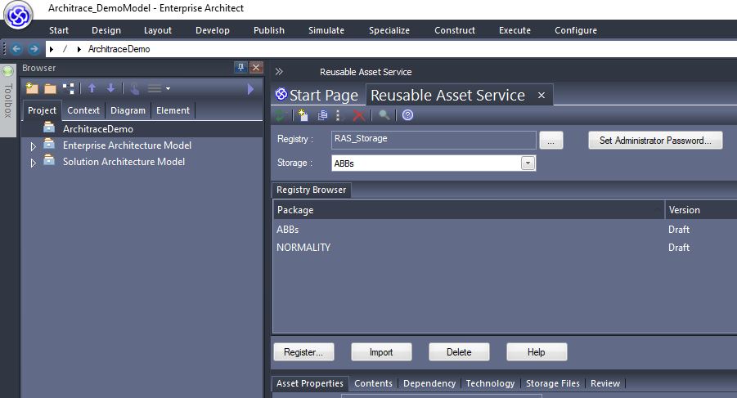
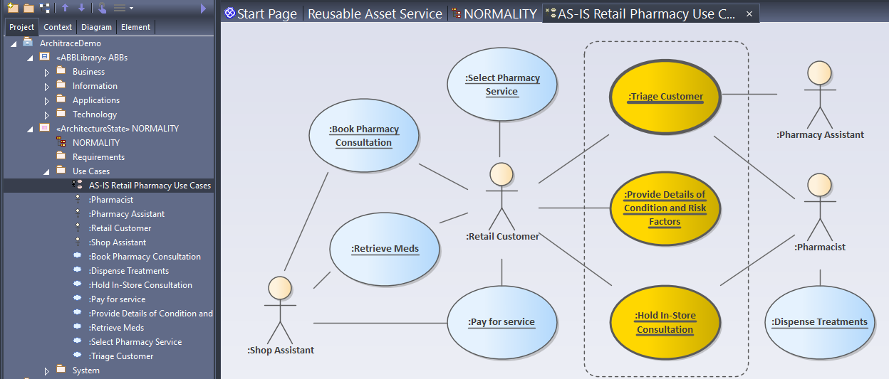
Import to coproduction workspace

Slide 18
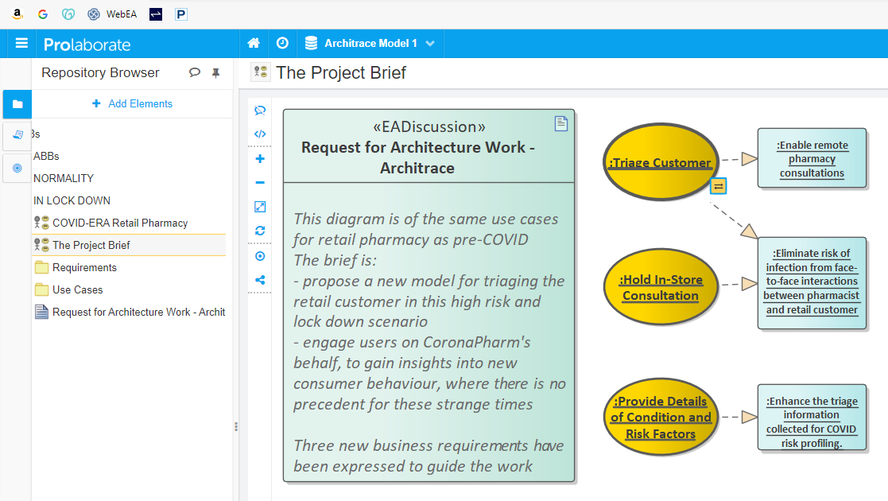
Openly architect
OpenUK The Open Source Industry Foundation

Slide 19
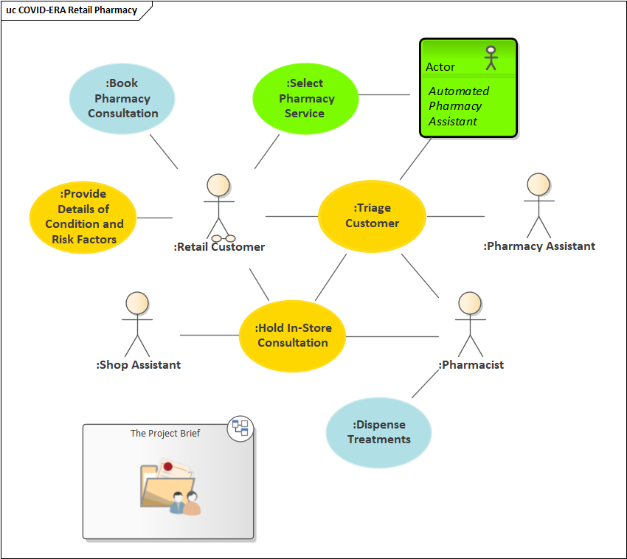
Refine the architecture (in cloud EA)
Use Case Discussions.PDF
Requirements Discussions.PDF

Slide 20
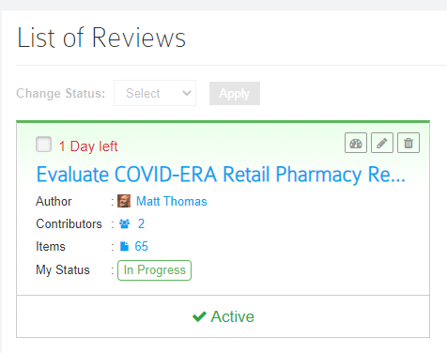
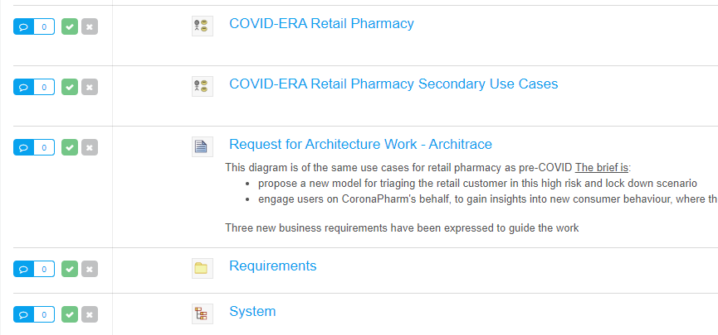
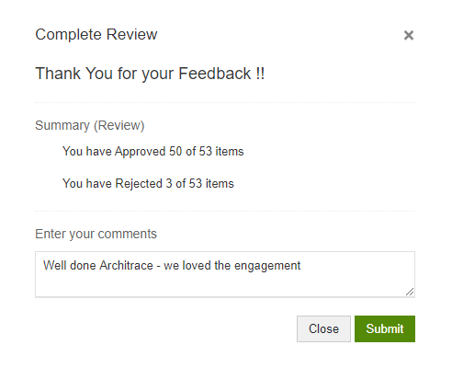
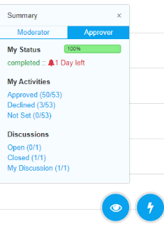
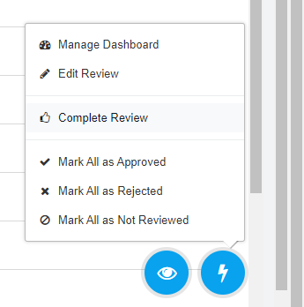
Approve the candidate

Slide 21
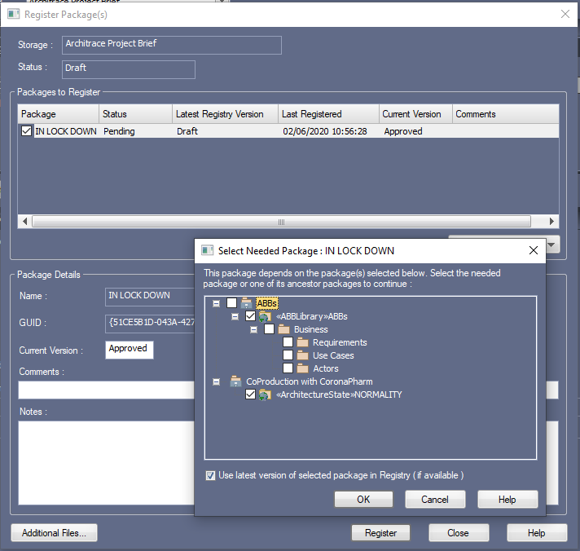
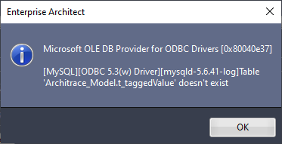
Roundtrip candidate architecture
Publish to RAS
Examine differences, ensuring no nasty surprises
Update the existing storage

Slide 22
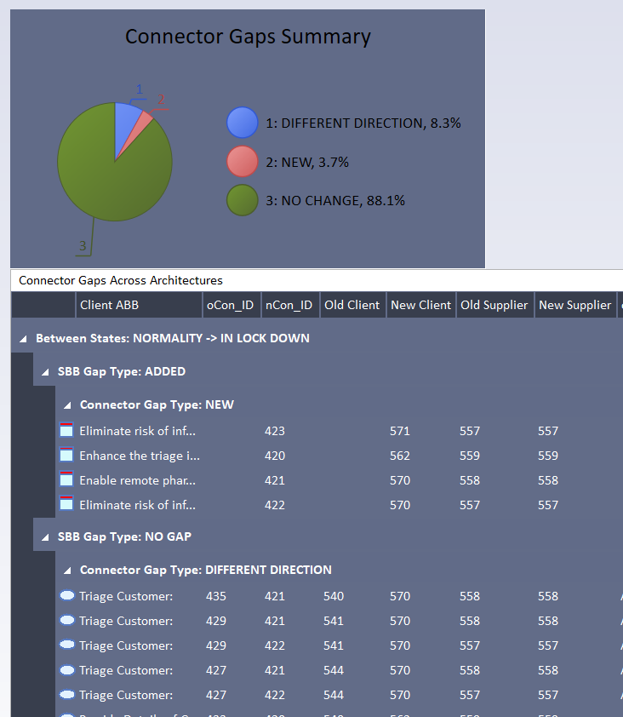
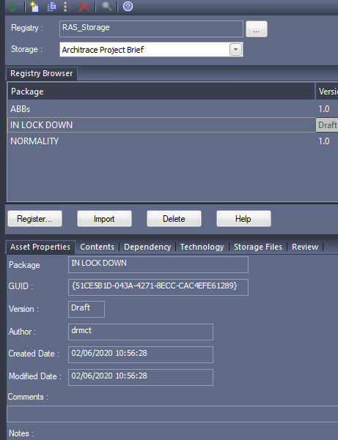
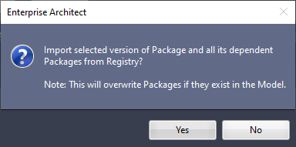
Harvesting, and analysing gaps
Bringing in the RAS storage
Firing up the gap analysis

Slide 23
Review our Coproduction approach
We aimed to show a way to thrive through this period of enruption, and beyond :
A method for engaging across your supply chain using the very best tooling
Balancing the needs of fluid modelling with the need to maintain a well-governed architecture repository
Address latent cultural reservations over using cloud for architecture blueprint work: bring benefits but mitigate risk
How did we do?

Slide 24
Anything you would like to ask … ?
Does this approach address your reservations about Cloud?
Why should I consider doing coproduction?
What do I need to do coproduction?
Does it support versioning or rollback etc.?
Tell me more about modelling with instances and using building blocks?
Security?

Slide 25
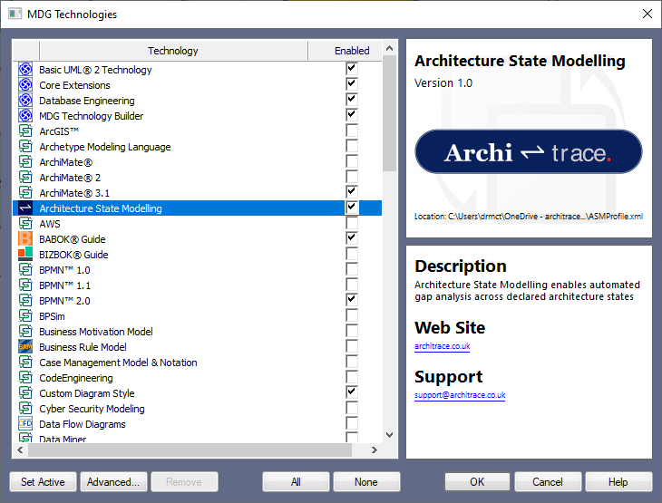
Comprehensive Turnkey Architecture Repository
TOGAF® Structured
Toolboxes
Modelling temporal architectures*
Gap Analysis Tool*
Architecture metamodel knowledge-base*
*

Slide 26
Contact Us
https://architrace.co.uk
info@architrace.co.uk
Expressions of interest
Applying the Coproduction approach
Turnkey repository
Architecture modelling consultancy

Slide 27
