Slide 1
Getting the best out of an mdg
Presented by Phil Chudley
©2020 Dunstan Thomas Consulting Limited

Slide 2
Agenda
An MDG Defined
The Typical Contents of an MDG
Extras that can be Added to Make an MDG “Sing & Dance”
Workflow for the Development of an MDG
Recommended Folder Structure / Names for MDG Files
An Example MDG
Demonstration of of an MDG
Questions & Answers

Slide 3
What is an MDG?
A Metamodel Definition
A Complete Modelling Environment
Elements & Relationships

Slide 4
What Must be in an MDG?
A profile
One or more stereotypes (extends a Metaclass)
One or more attributes
String
Enumeration
Pre-defined Tagged Values
Typed by
Shapescript
Icon

Slide 5
What Should be in an MDG?
One or more custom toolboxes
One or more custom diagrams

Slide 6
MDG – Extra ‘Goodies’
Meta Relationship
Stereotype Relationship
Meta Constraint
Defines Quicklink rules
View Specification
Defines a custom diagram with a subsetted toolbox

Slide 7
MDG – Optional Extras
Images, Scripts & Pre-defined Searches
Doc Gen Templates
Code Generation Templates
MDA Templates
Workspace Layouts, Model Views
Model Wizards

Slide 8
Workflow for Building a Basic MDG
Start
Define any Tagged Values (Date, Memo etc)
For each element in the Meta model:
Add the tagged values
and Shapescript
Define a Toolbox to contain all Elements and Relationships
Generate the MDG using an MTS file
Define the Meta model
Test the MDG
Ensure MDG Technology Builder is in your Perspective
Define any Enumerations
Define a Diagram to use this toolbox
For each relationship in the Meta model:
Add a stereotype to the Profile diagram
Define Quicklink Rules and View specifications
For each element in the Meta model:
Add a stereotype to the Profile diagram
Save the Profile, Toolbox and Diagram
Create a new Repository and structure using the MDG Technology Builder Wizard
Test the MDG
End

Slide 9
Workflow for Adding the ‘goodies’ to an MDG
Start
Add any Meta Relationships to the Profile
Define the View Specifications
Test the MDG
Add any Stereotyped Relationships to the Model
Save the Profile, Toolbox and Diagram
End
Add any Meta Constraints to the Model
Generate the MDG using an MTS file

Slide 10
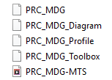
Recommended Folder Structure / Names for MDG Files
Using a Folder for MDG
Create a Child Folder for the Images
Create a child folder for the XML files
One eapx file for the MDG
One eapx file for testing the MDG
In the XML folder use the name MDG Name as a prefix and the what the file represents as a suffix

Slide 11
Example Meta Model
Cause
Problem
Generalises / Made up of
Origin of
Ticket Status
Raised
Acknowledged
Assigned
In Progress
Completed
Undefined
Solved by
DateIdentified
Type=Date;
Solution
CauseDetails
Type=Memo;
Generalises / Made up of

Slide 12
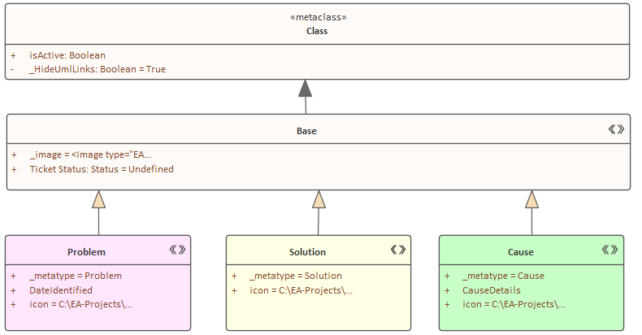
Profile - Elements
_HideUmlLinks: Boolean = True
Used for Quicklink Definitions
A common base stereotype is defined to contain the common tagged value(s) and a common shapescript
Colours defined in the profile not the Shapescript allow a user to modify the background colour
icon is optional

Slide 13
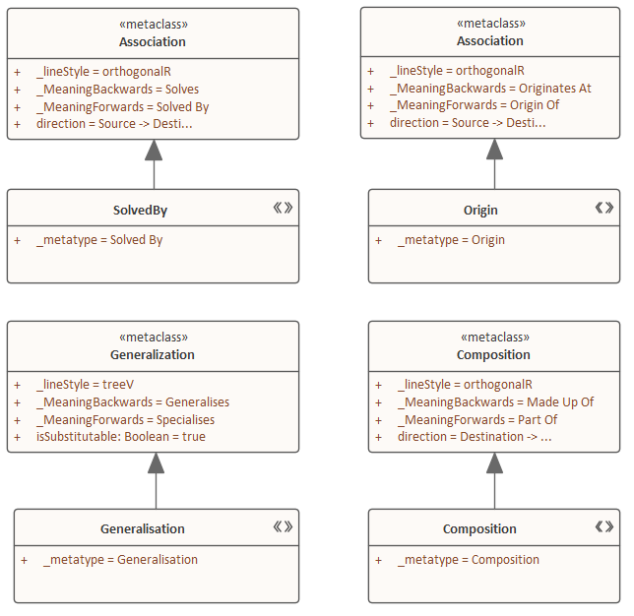
Profile - Relationships
_MeaningForwards
_MeaningBackwards
Used for Quicklink Definitions

Slide 14
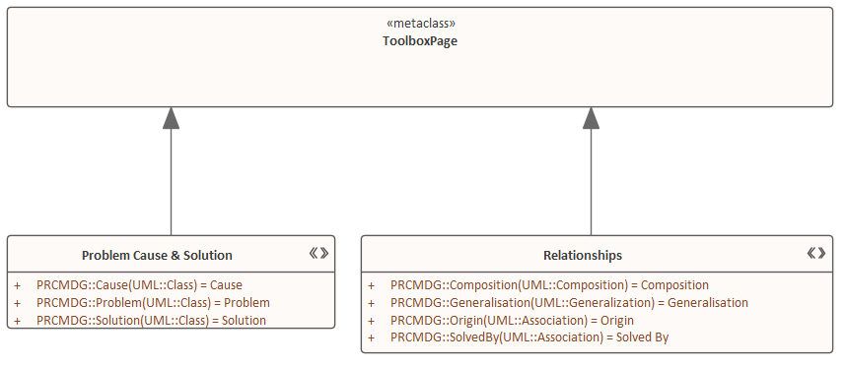
Toolbox Profile
Toolbox Pages Are Ordered as per Z-Order
Bottom = Toolbox at the Top

Slide 15
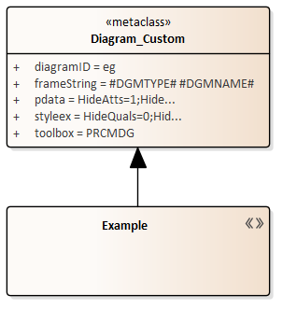
Diagram Profile

Slide 16
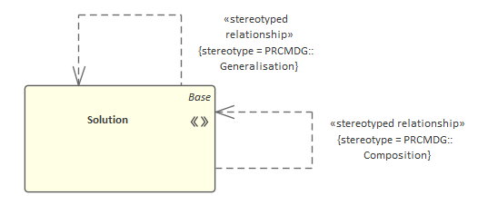
Stereotyped Relationships
A stereotyped relationship is used to specify the Quicklink
One diagram per stereotype is used to define the stereotyped relationships from this stereotype

Slide 17
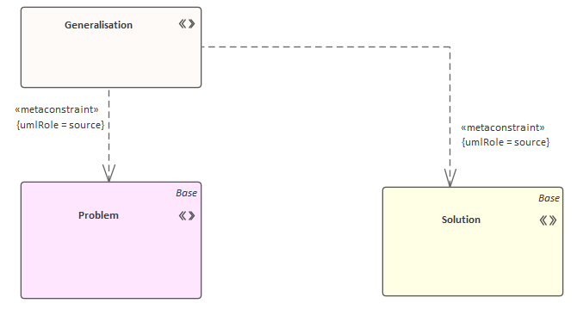
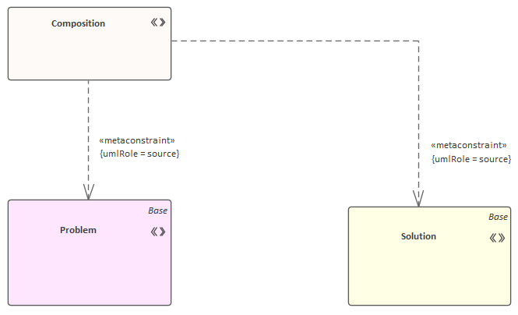
Stereotyped Meta Constraints
A metaconstraint relationship is used to apply quicklink rules when using the toolbox for creating relationships
One diagram per metaconstraint is used to define the source(s) of relationships

Slide 18
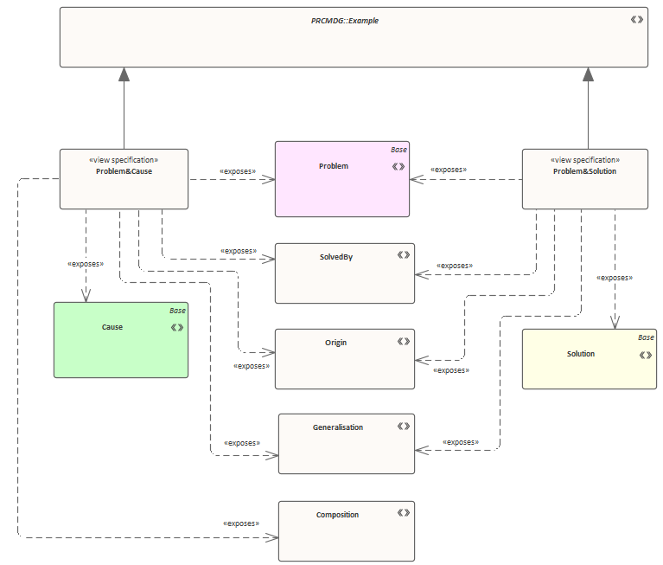
View Specifications
A view specification is used to define a viewpoint with a specific subset of elements / relationships from a toolbox associated with a custom diagram
This is modelled using an exposes relationship

Slide 19
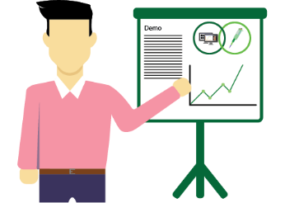
Demonstration

Slide 20
Questions?

