Slide 1
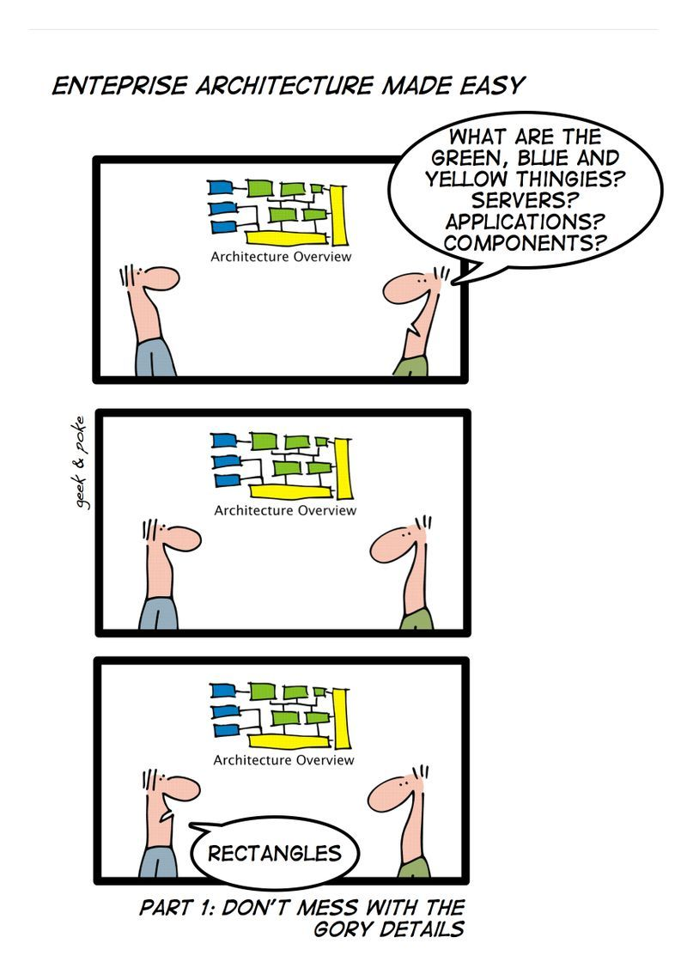

Slide 2
EA STAKEHOLDER’S HIERARCHY OF NEEDS
Be up-to-date on modeling and architecture efforts
View Model information
Visualize model information to take key decisions
Collaborate with EA users and other stakeholders in a better way
Analyze model to derive insights

Slide 3
EA STAKEHOLDER’S HIERARCHY OF NEEDS
Simplify/Share/Integrate
Access controls, Role-based dashboards, Jira. Azure DevOps Integration
Share/Publish
Links, Confluence/SharePoint Integration
Visualize
Advanced charts and reports
Collaborate/Edit
Review, Discuss, Edit
Analyze
Diagrammer and Matrices

Slide 4
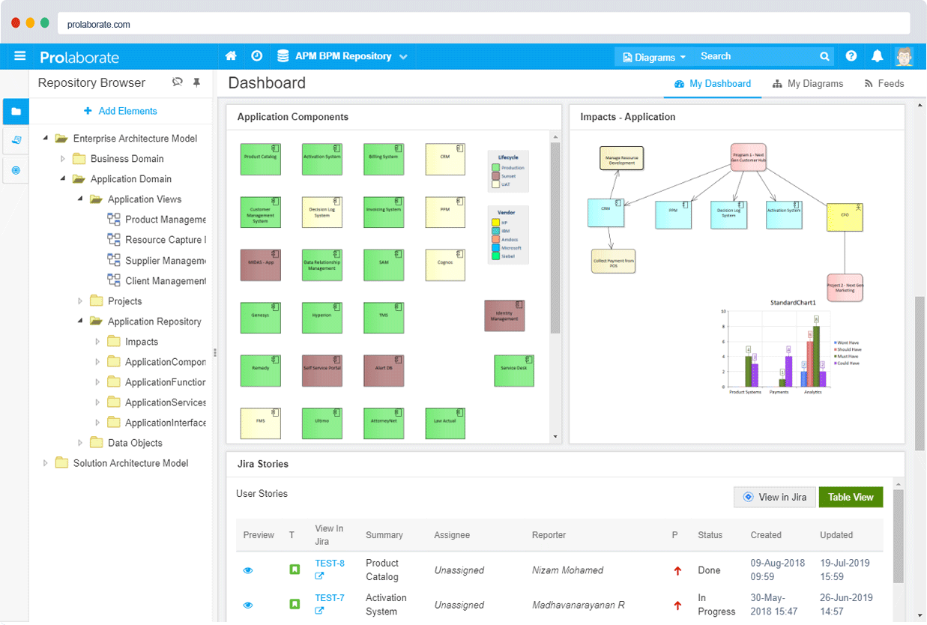
SHARE

Slide 5
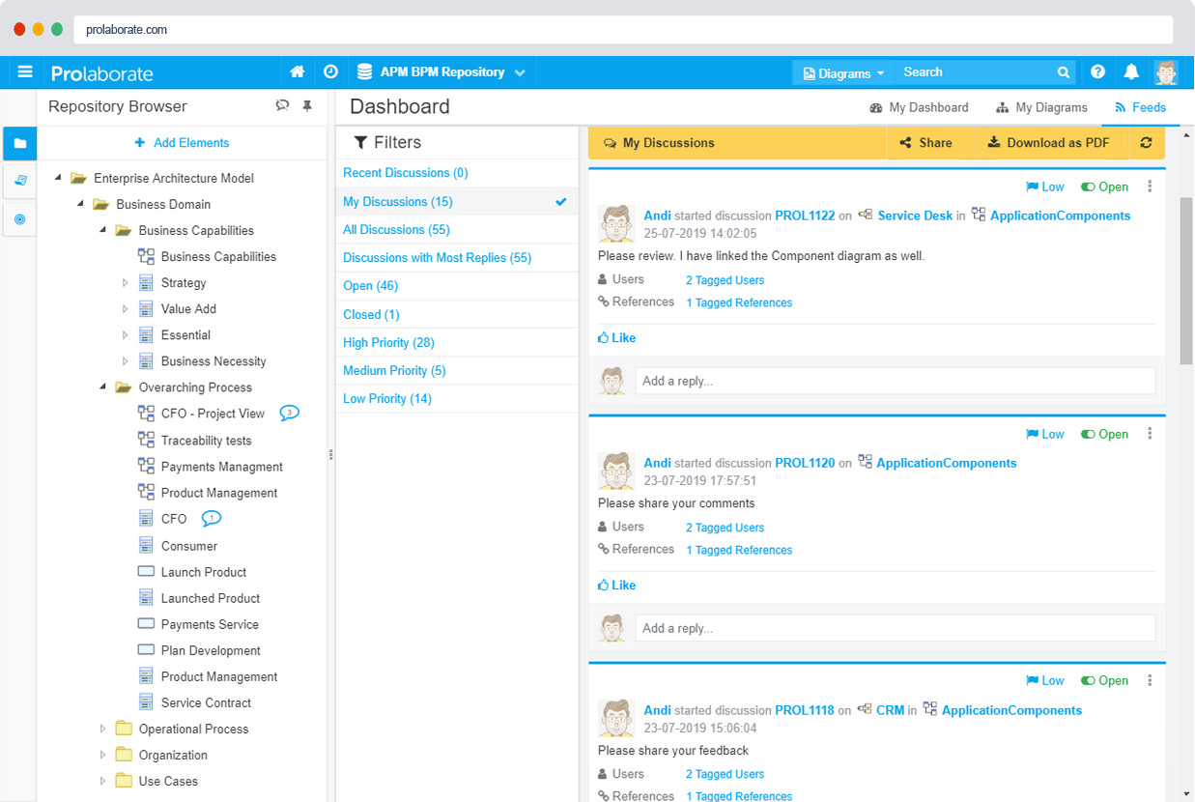
collaborate

Slide 6
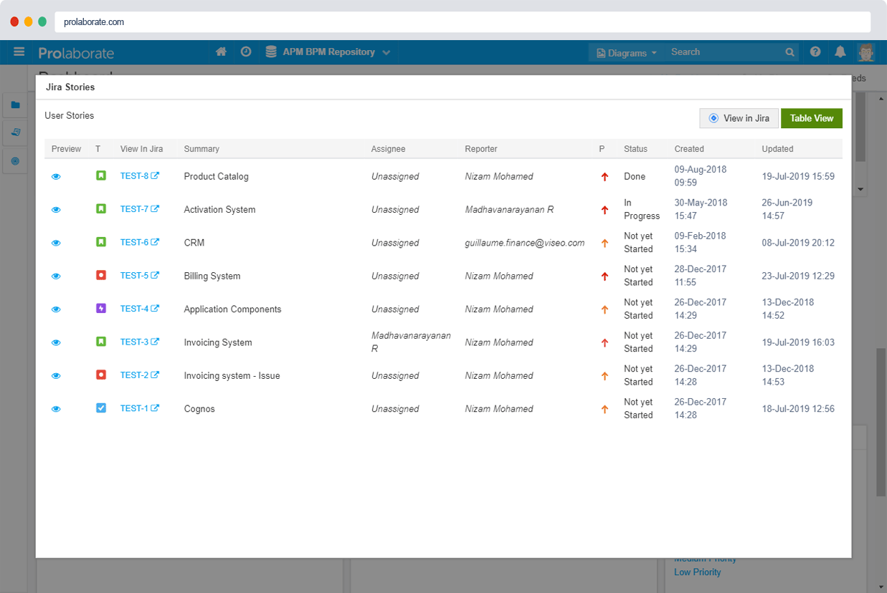
INTEGRATE

Slide 7
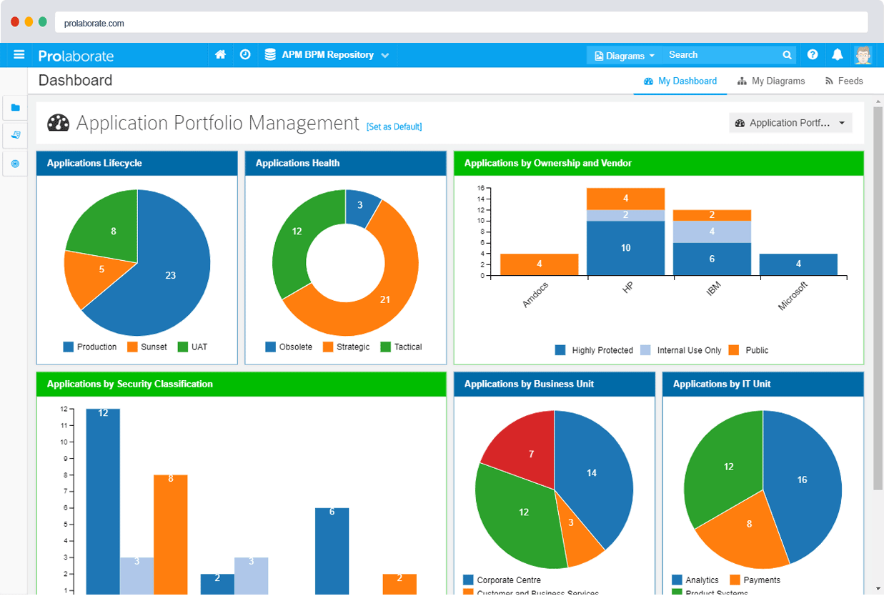
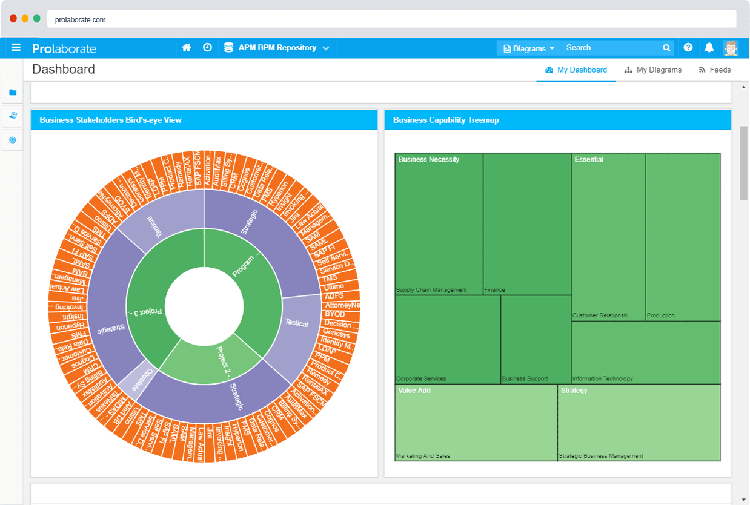
visualize

Slide 8
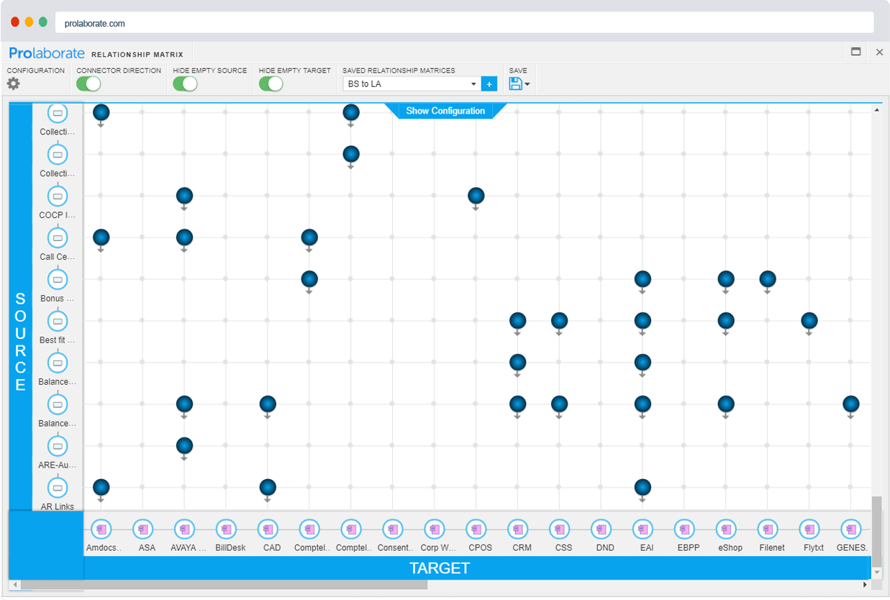
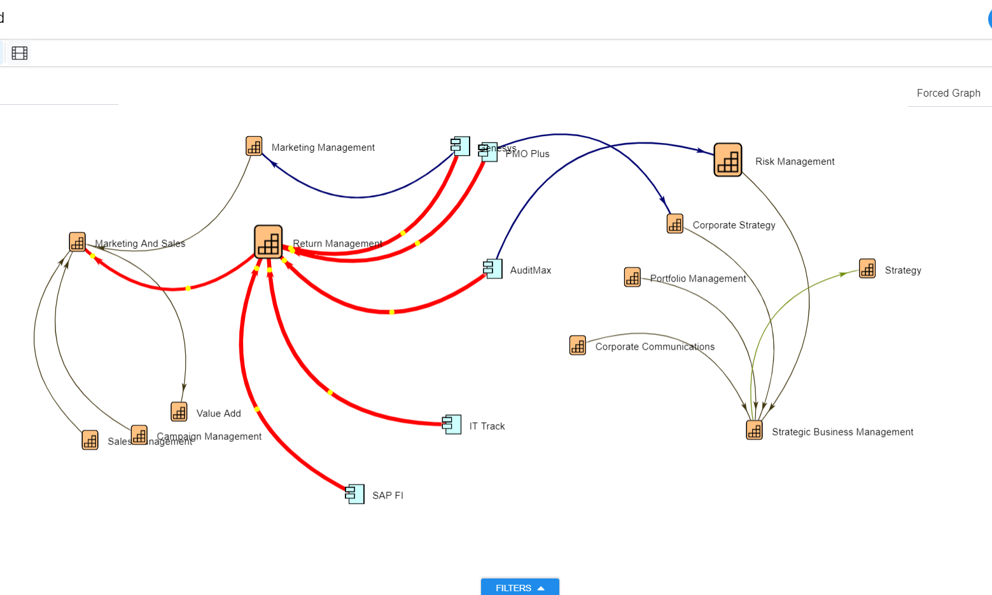
ANALYZE

Slide 9
Agenda
Customer Case Study
Objective
User Experience
How it works?

Slide 10
What’s the gap?
Share and re-share - Vicious cycle
Static information

Slide 11
goal
Engage business users by taking EA model information to the tools they use on a daily basis

Slide 12
customer case study
Background:
Fortune Global 500 company
Location:
Australia
Goal:
Effectively share and collaborate on EA models using Confluence
Notes:
This Australian company featured in Fortune Global 500 use Confluence extensively for their documentation and obviously Sparx EA for their modeling needs

Slide 13
after – the solution and results
before – the problem
Share information from EA models from with in Confluence (Just once)
Live information. Better adoption of EA. Any business user can view and publish. No need to learn a new app
Ineffective publishing methods - Pasting screenshots regularly and documenting the information that is already available
Notes:
I am sure all the Confluence and Sparx EA users can relate to this problem. Copy pasting is not a good solution for sharing!

Slide 14
User Experience
View live Diagrams & drill-down on Composites
Browse contents of Packages & details of Elements
Browse through
Repositories
View and interact with Charts & Visualizations

Slide 15
How it works?
Macro
Links

Slide 16
How it works?
Configure
Share
Prerequisite: installation and configuration

Slide 17
GET STARTED
Scenario | Requirements | Products to Purchase
1 | We want to share live information in Confluence using the macro | Growing Teams Edition (10-licensed users) and Integrations add-on
2 | Scenario #1 + capability to share repositories and visualizations using links | Growing Teams Edition (10-licensed users), Integrations and Open Community Access add-on
3 | Use Prolaborate for sharing, collaborating, integrating, visualizing, and analyzing EA models | Large Teams Edition – 100 licensed users

Slide 18
GET STARTED - FAQs
How many users can use the Prolaborate macro?
No limitations as of now
Is the macro compatible with Confluence Server or Cloud or Both?
Both

Slide 19
CONFIGURATION FAQs
From where can I get the macro?
Atlassian Marketplace
What are prerequisites to install it?
Prolaborate installation
Link between Confluence server and Prolaborate app server

Slide 20
USAGE FAQs
Will the whole model to exposed to everyone in Confluence?
You can control access at a granular level.
How to expose specific metadata and notes in Confluence?
Requires a one-time configuration in Prolaborate.

Slide 21
Evaluation Options
Free Proof of Concept on-premises
Paid Proof of Concept on Cloud

