Slide 1
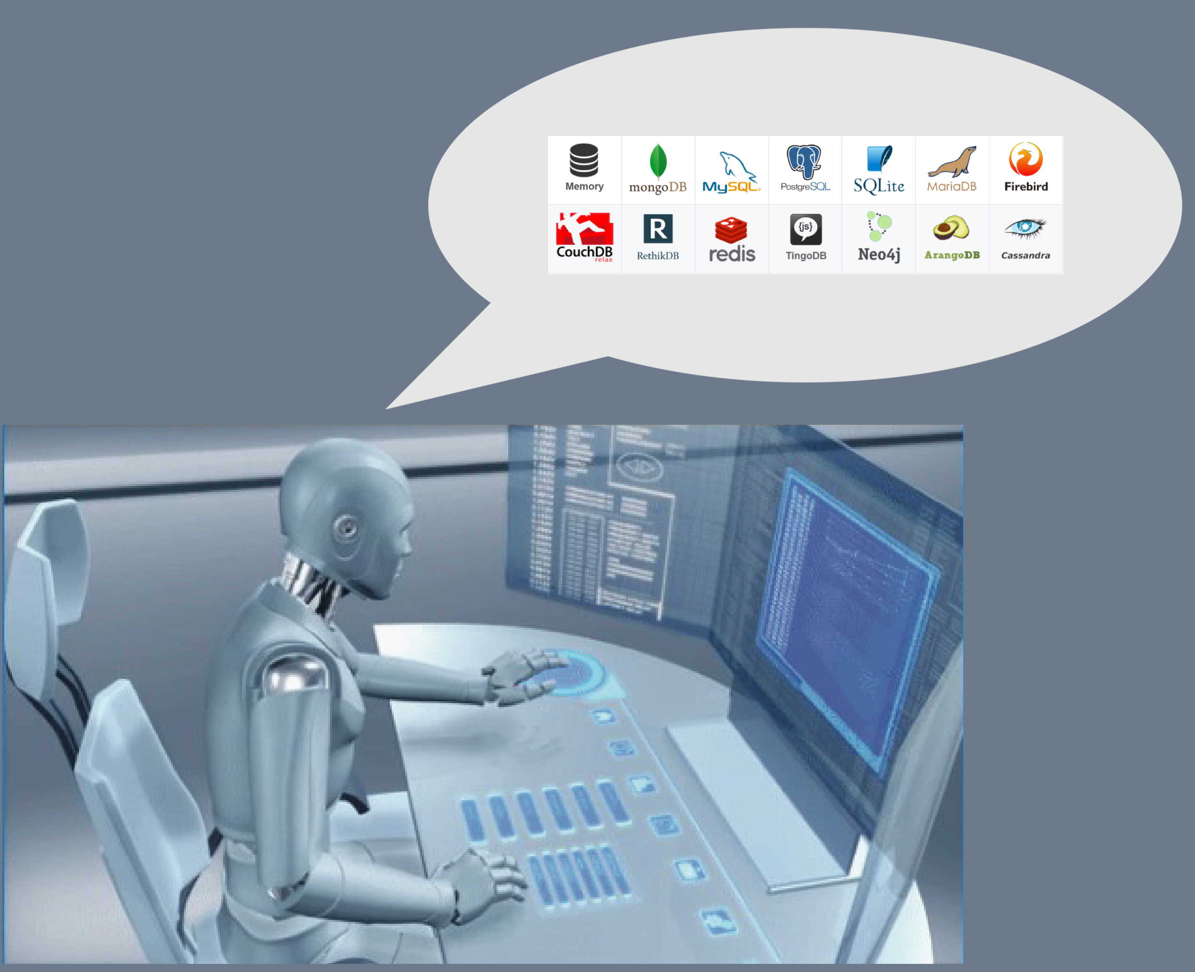
CodeBot UX: Generate code from EA wireframes
Doug Rosenberg
Parallel Agile, Inc.

Slide 2
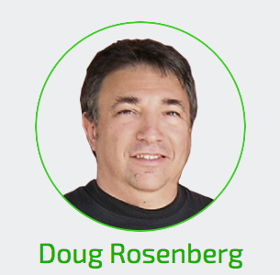
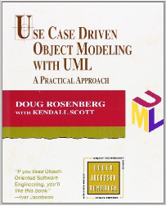
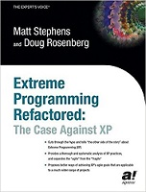
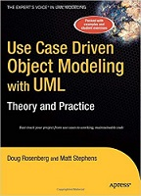
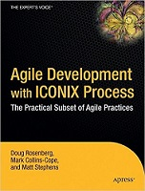
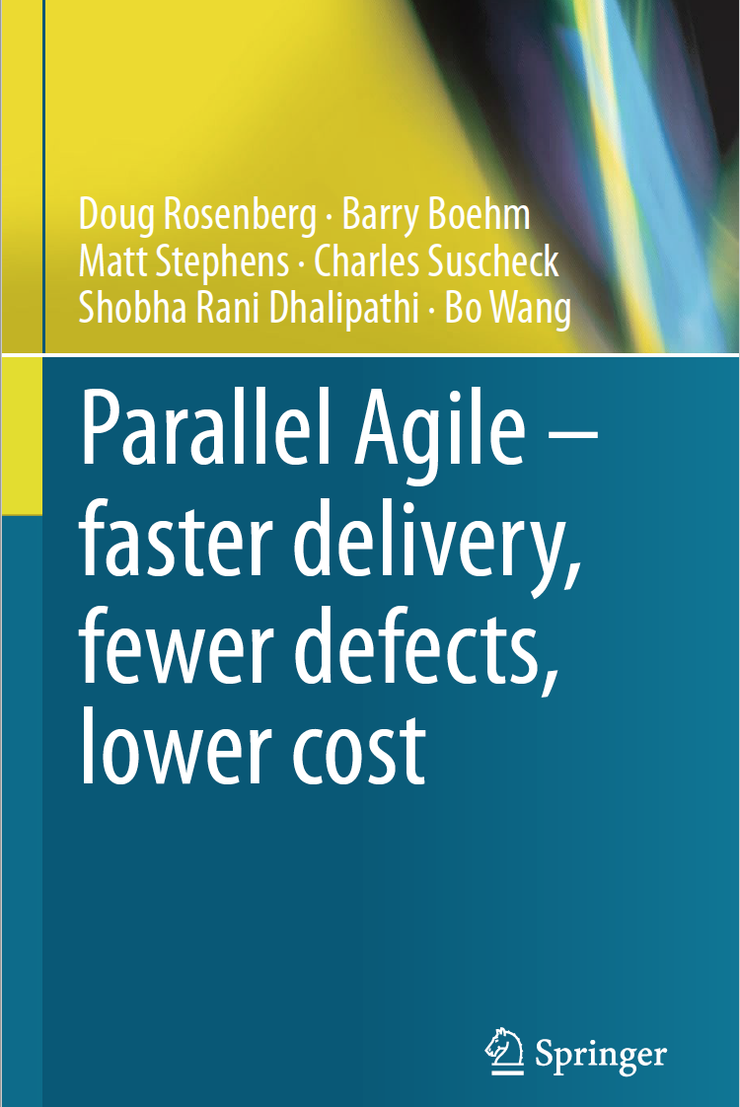
Allow myself to introduce…ourselves
doug@parallelagile.com
1999
2020
1984 - Started ICONIX
1986 - Met Barry Boehm
1997 – UML created
2000 - Met Chuck Suscheck
2002 - Met Matt Stephens (creator of CodeBot)
2005 - Joined Sparx Systems partner program
2014 - Started researching Parallel Agile @USC

Slide 3
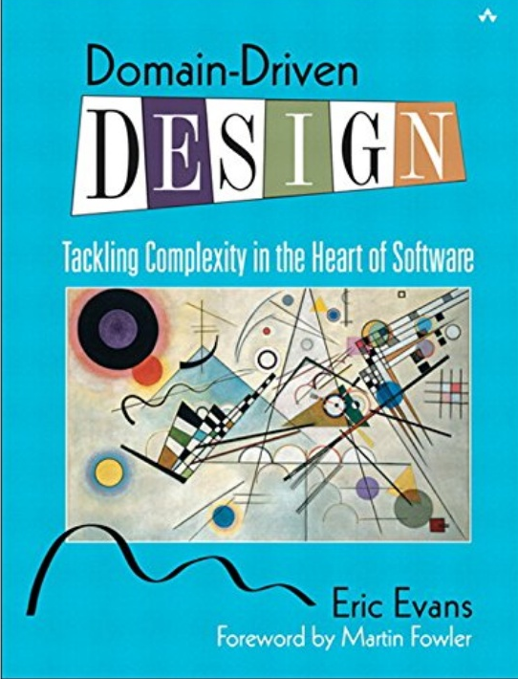
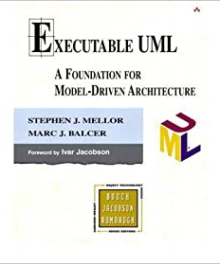
Evolution of CodeBot
2014-2015 – we discover a domain driven design pattern at USC
2016-2018 – I mentor a PhD student on code generation (Mongo DB/Node.js)
2019 – Industrial strength, retargetable CodeBot
2019-2020 – CodeBot retargeting
2020-2021 – CodeBot UX, MVC Code Generation

Slide 4
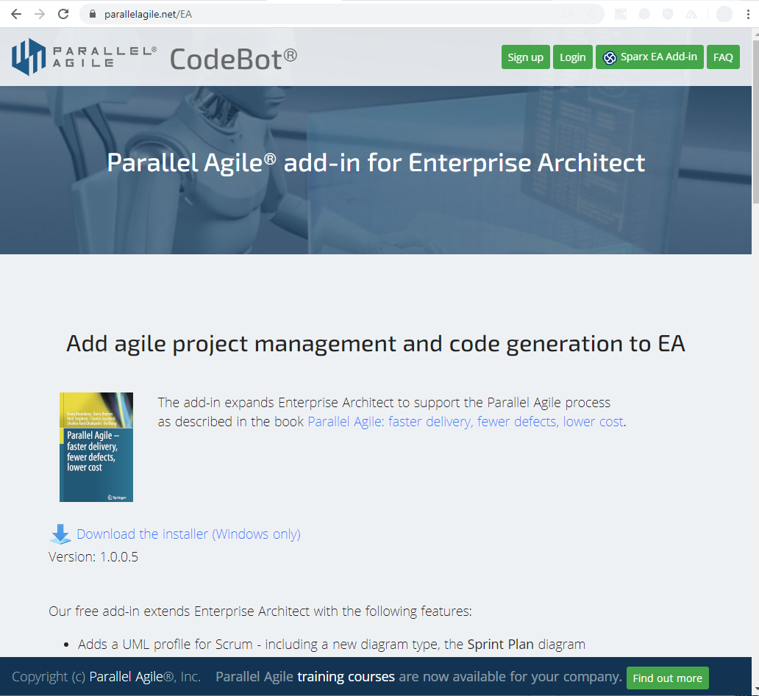
Access CodeBot through the Parallel Agile Add-In
Parallel Agile Add-In is free
Download from parallelagile.net/EA
CodeBot is free to try
CodeBot license is $499/year
Early Adopter license is available

Slide 5
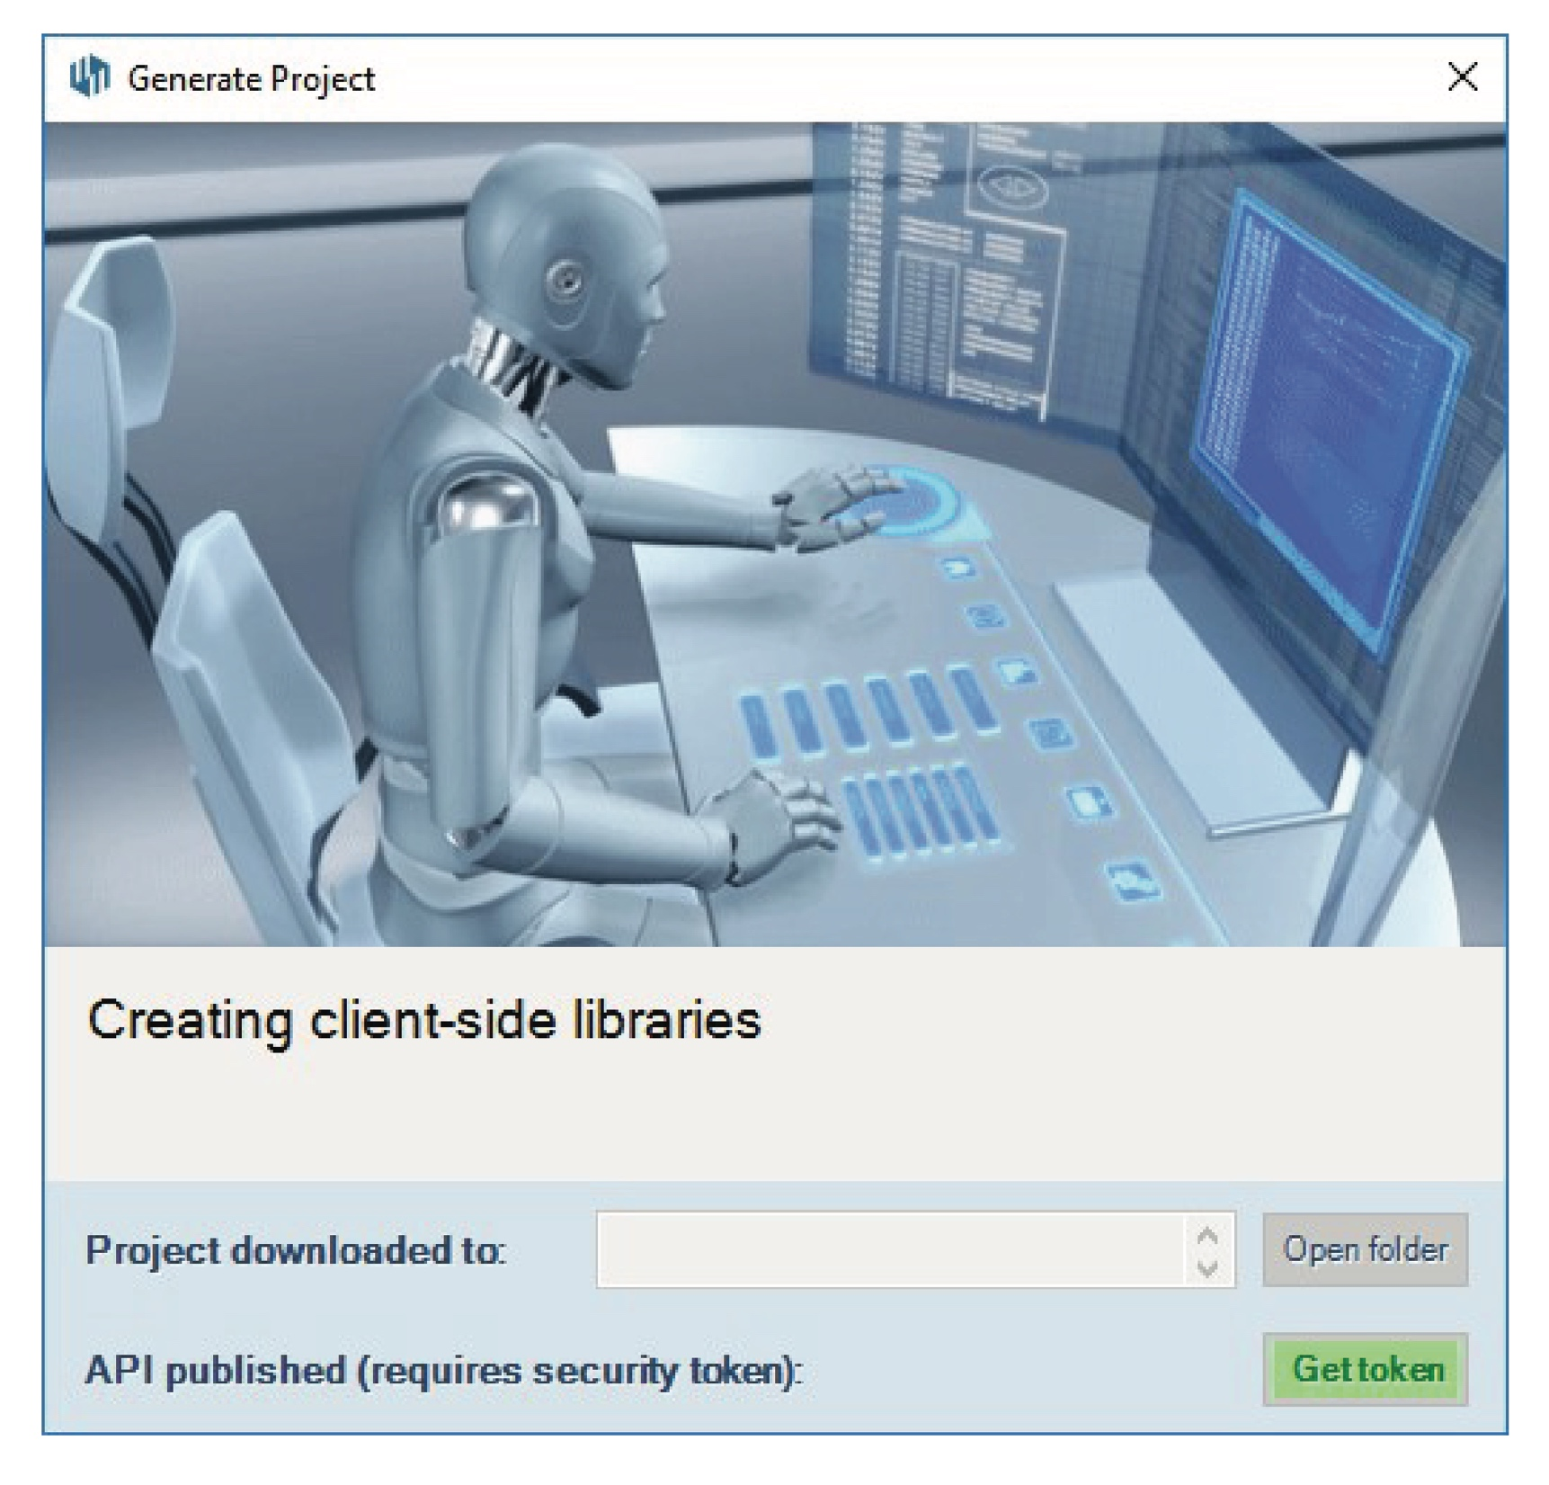
CodeBot turns a domain model into an executable architecture
Generates MongoDB and Node.js from a UML Domain Model
Server side code, Client Side Code, API documentation
Automatic web hosting and deployment for immediate API testing
Built in Scala
Template driven using TWIRL

Slide 6
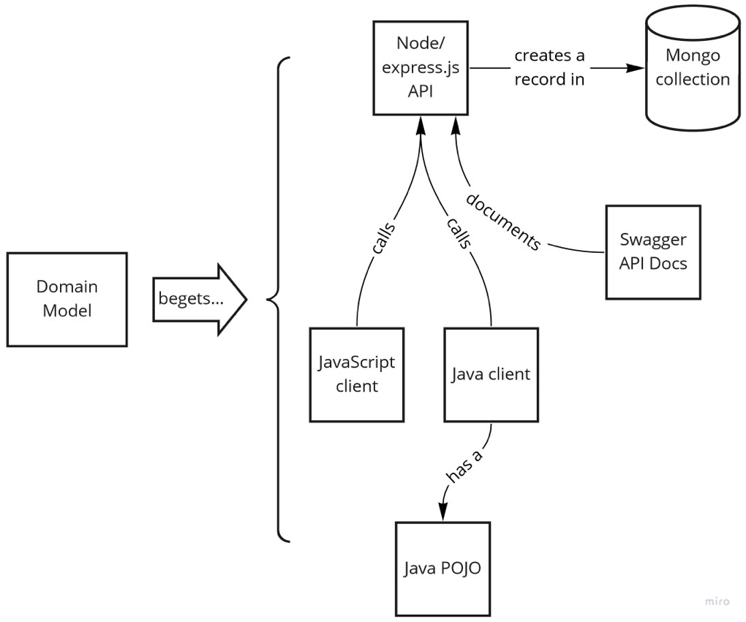
CodeBot turns a domain model into an executable architecture
Generates MongoDB and Node.js from a UML Domain Model
Server side code, Client Side Code, API documentation
Automatic web hosting and deployment for immediate API testing

Slide 7
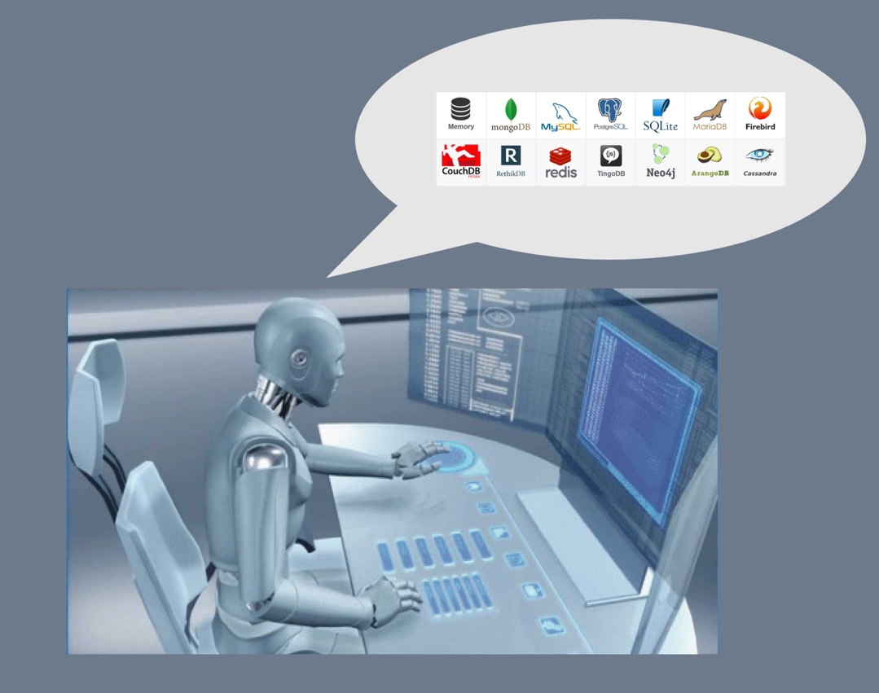
We’ll be deploying additional database targets soon
Oracle
PostgreSQL
SQL Server
MySQL
Redis
…
Early adopters wanted!

Slide 8
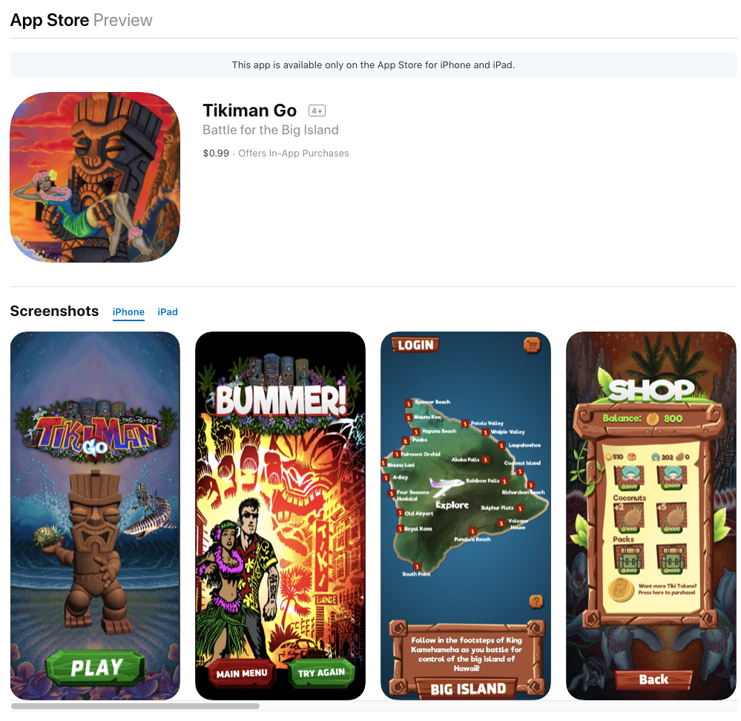
Example: TikiMan Go game --- designed with Enterprise Architect
Test project for Parallel Agile
Hawaiian themed VR/AR game
Designed with Enterprise Architect
Use Cases, Domain Model, MVC
Unity 3D connected to Mongo DB via Node.js
Mongo/Node code generated from EA Domain Model
Recently published for Android and iOS
VR version published
AR version in development
Example is from currently ongoing development

Slide 9
Part 1 Updating the TikiMan database and API for Achievements
Version 1 of TikiMan Go was published without Achievements
Version 2 needs to extend the database schema to handle this feature
Procedure
Design the new schema
Update the domain model in EA
Re-generate the database and API
No Node.js or MongoDB coding required!

Slide 10
1. Update the domain model for Achievements

Slide 11
2. Re-generate the project from EA

Slide 12
CodeBot builds database, API, API docs

Slide 13
A few seconds later…

Slide 14
You’ve got server-side code, client-side code, and API Docs

Slide 15
JavaScript client-side code
Each class on the domain model is generated for both server side and client side
JavaScript client is shown at right
Java client also generated (C# and Swift coming soon)

Slide 16
Achievements Client-Side Code (Create, Read, Update Delete)
Database access functions are generated for each domain object
Success and error callbacks included for each method
Client side code calls the generated server side API

Slide 17
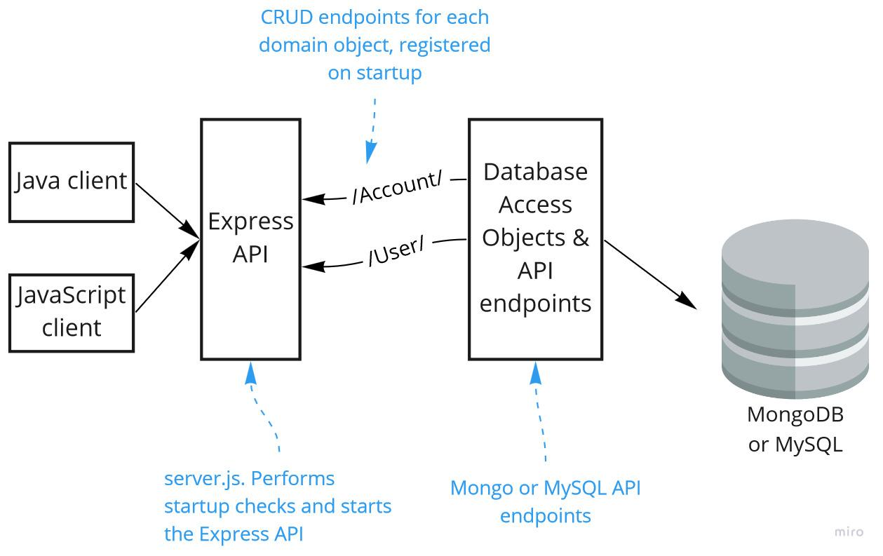
Achievements Server-side code (Get, Put, Post, etc)

Slide 18
API Documentation generated automatically

Slide 19
API Docs - Achievements
API is auto-hosted for immediate testing
Hosting is optional and not required

Slide 20
API Docs – Achievements GET/PUT/POST

Slide 21
Getting access token to test API

Slide 22
POSTMAN testing of hosted API
API is hosted and available for testing within a few seconds of updating the domain model in Enterprise Architect!

Slide 23
API is working! (POST)

Slide 24
API is working! (GET)
Server side code generated
Client side code generated
API documentation generated
API hosted and testable
API is working

Slide 25
Coming soon…caching with Redis

Slide 26
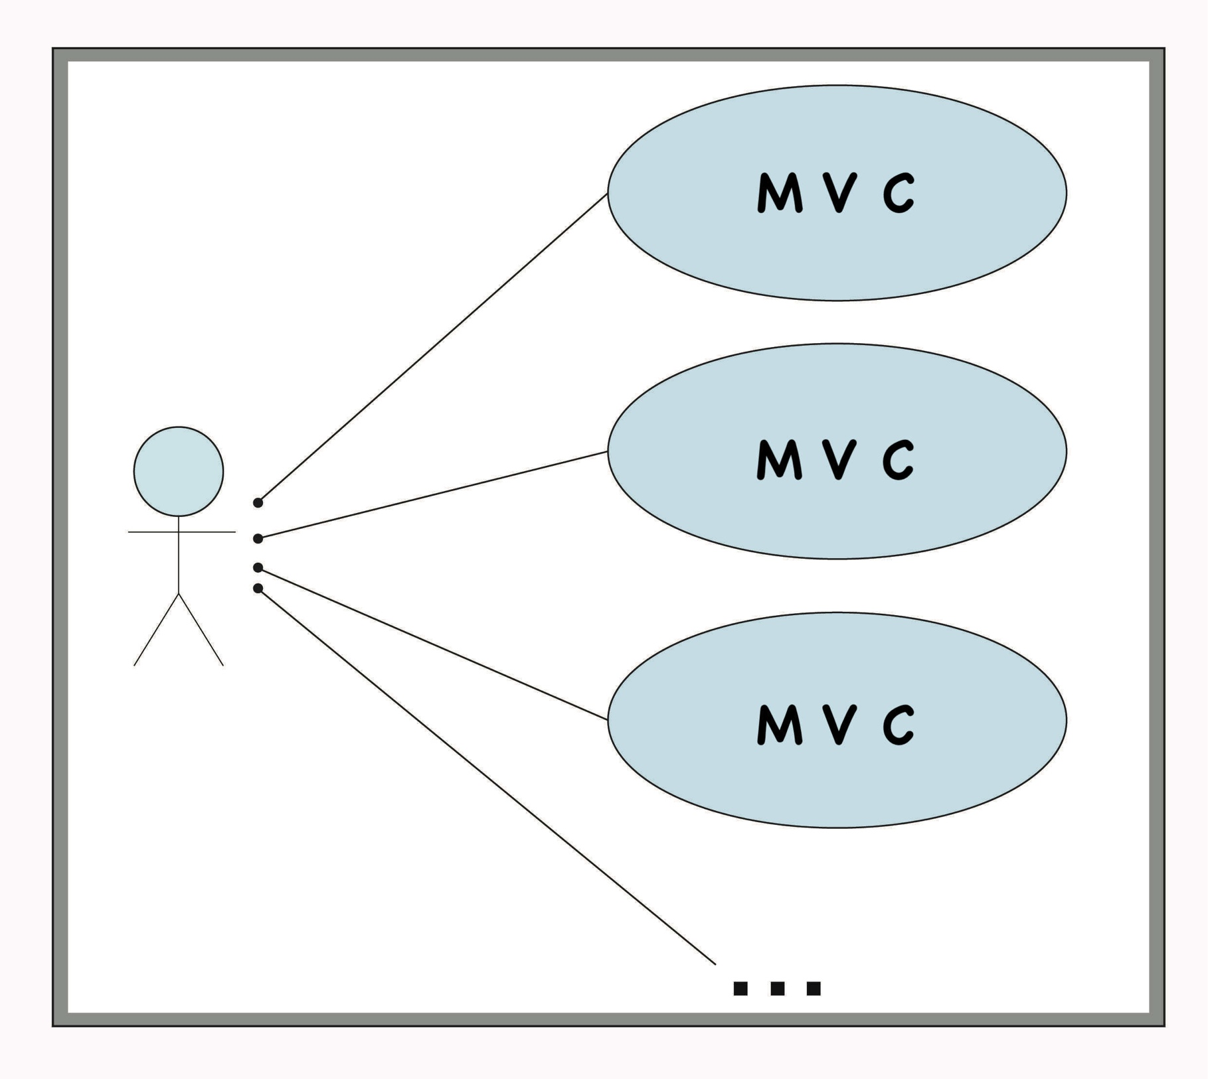
Holy Grail – full MVC Code Generation
Most use cases can be decomposed into Models, Views and Controllers
You can think of effort as (roughly) 1/3 Model, 1/3 View, and 1/3 Controller
Original CodeBot generates Model code

Slide 27
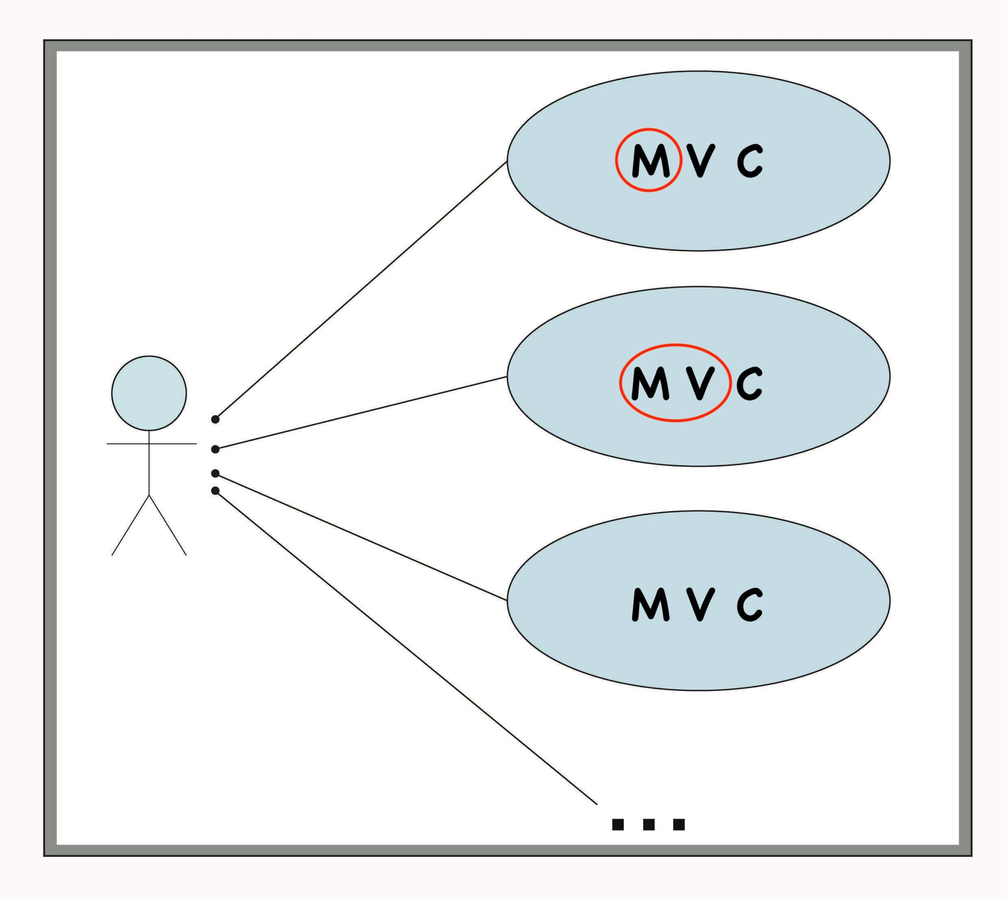
What if we could generate UI code as well as database code?
CodeBot UX
Generating MV instead of just M can potentially double the effectiveness of CodeBot
We can generate different View targets (e.g. React, Angular, Vue, Android, iOS)
Wireframes can be linked to domain objects

Slide 28
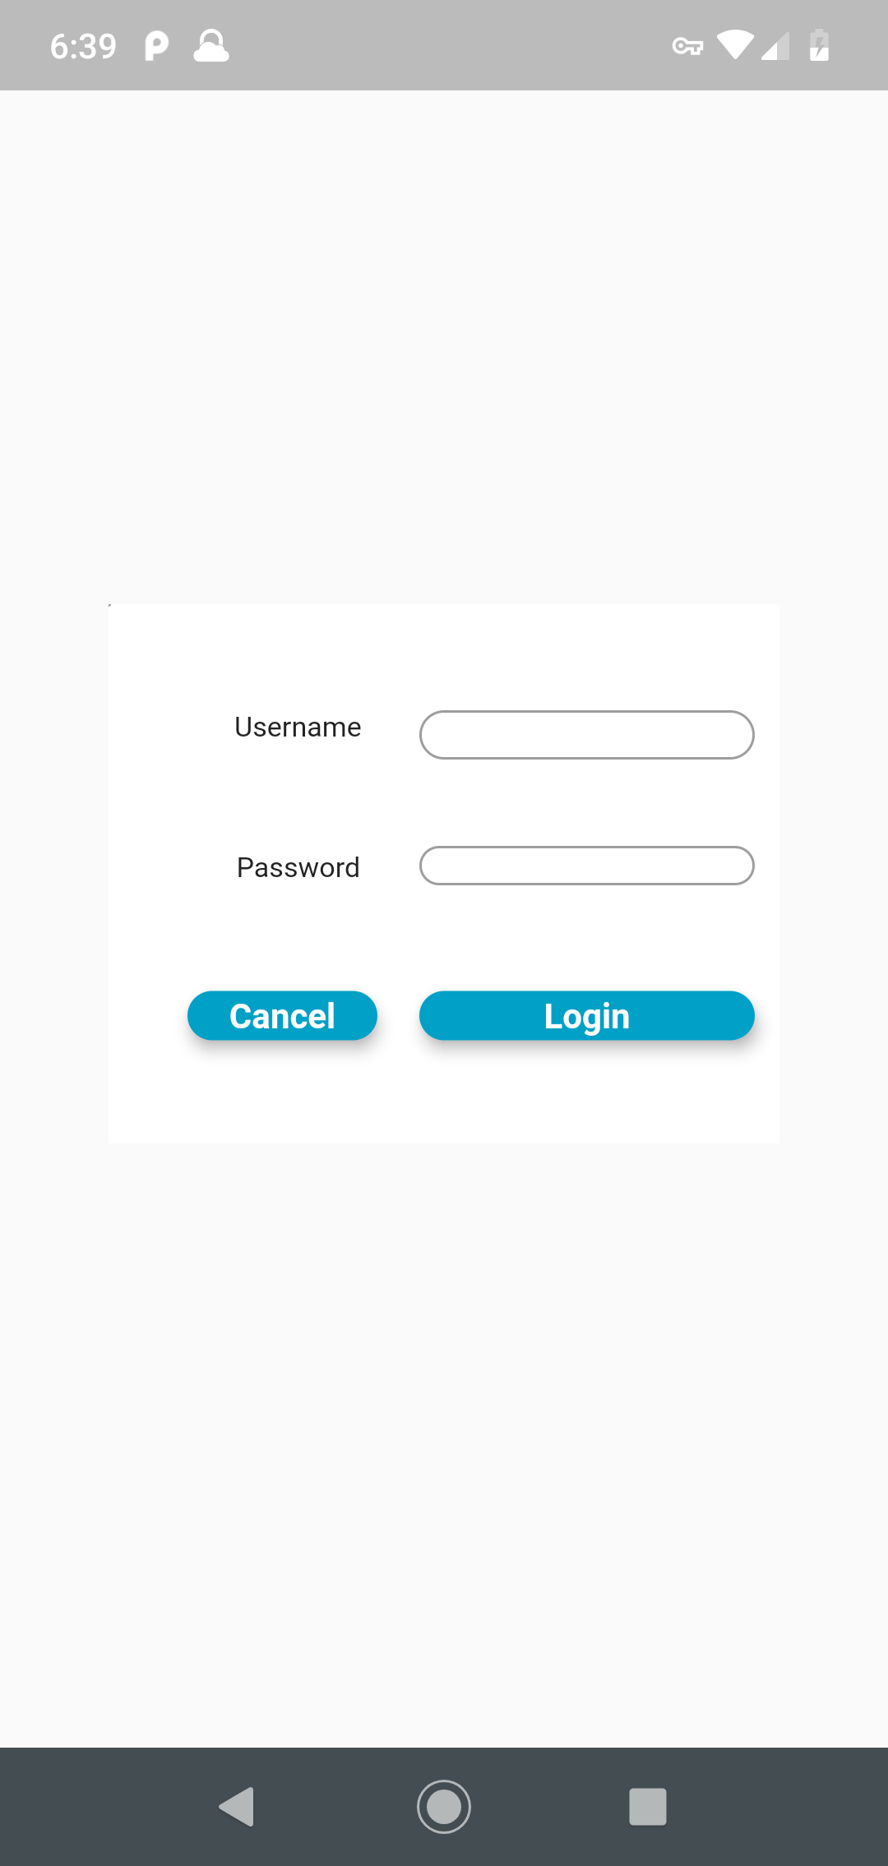
CodeBot UX – wireframe to mobile

Slide 29
CodeBot UX – wireframe to webapp

Slide 30
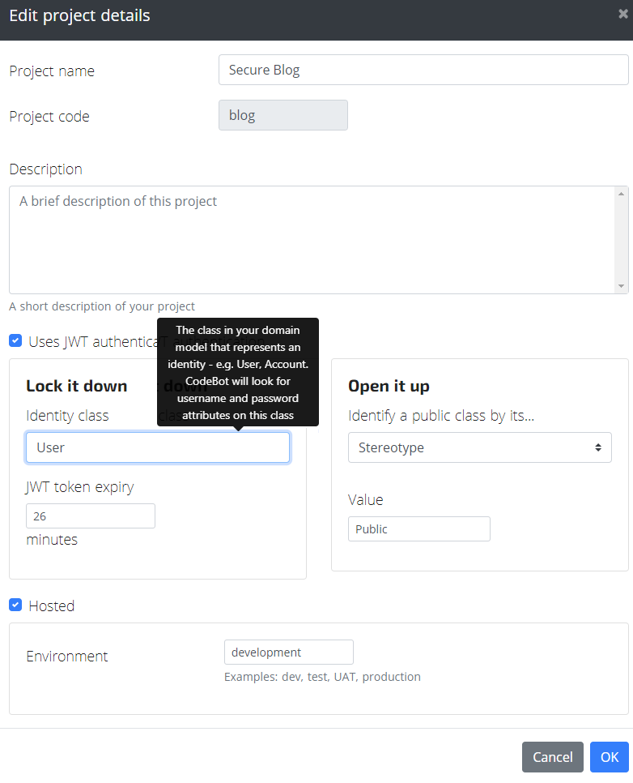
Generate a secure web application with JWT tokens
Generates a secure, JWT-based API and React UI
Lock down data so that only the right users have read or write access
Uses "sensible defaults" to minimize the amount of configuration required

Slide 31
Working towards Model View Controller Code Generation
Generate database and API from EA Domain Model (M)
Generate UI code from EA Wireframes (V)
Build your business logic in Enterprise Architect (C)
EA has some unique features for business logic
Business Rule Composer
Behavioral Code Generation from Activity, State, Sequence diagrams
(out of scope for this webinar but described in eBooks)

Slide 32
CodeBot UX – State Machine Code Generation
Link your screens together using state machines
Generate working applications with little or no coding

Slide 33
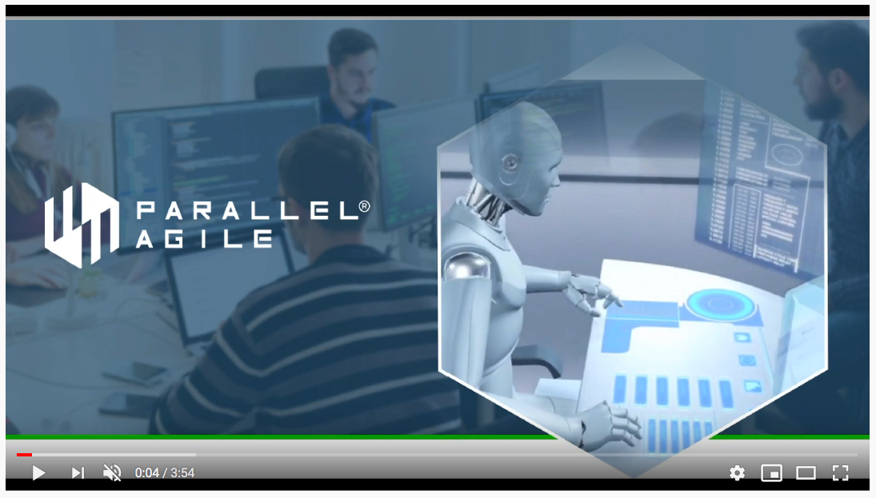
Demo – CodeBot UX Sneak Peek
https://www.youtube.com/watch?v=EnU-lrdd4DM

Slide 34
We’re looking for some early adopters…
We’ll be deploying some amazing new CodeBot functionality soon
If you’d like to help us with early release testing, let us know
CodeBot licenses come with an “early adopter” option that we can enable

Slide 35
Thank you!
Questions?
doug@parallelagile.com

