Slide 1

Agile Project Management with EA from sprint plans to Kanban boards to Jira tickets
Doug Rosenberg
Parallel Agile, Inc.

Slide 2
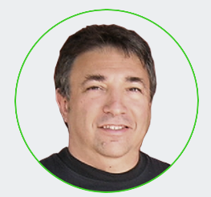


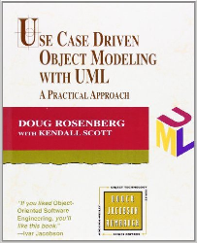

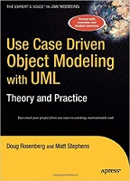
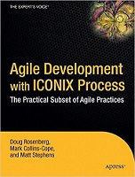

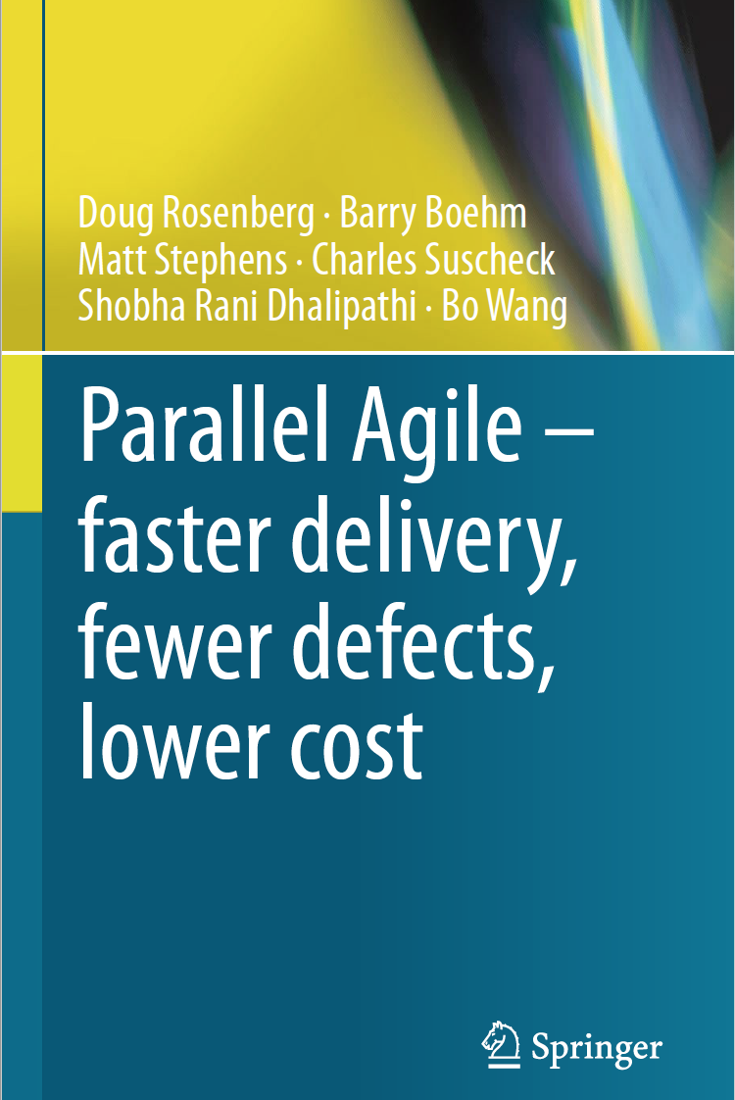
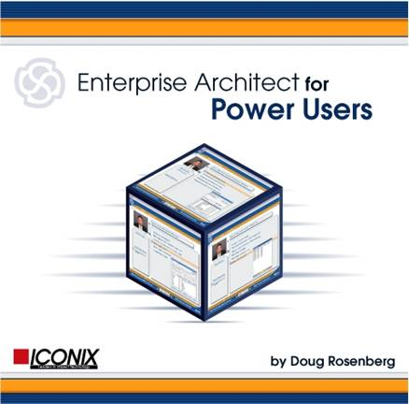
A word about me
doug@parallelagile.com
1999
2020
1984 - Started ICONIX
1986 - Met Barry Boehm
1995 – UML created
2000 - Met Chuck Suscheck
2002 - Met Matt Stephens
2005 - Joined Sparx Systems partner program
2014 - Started researching Parallel Agile @USC

Slide 3

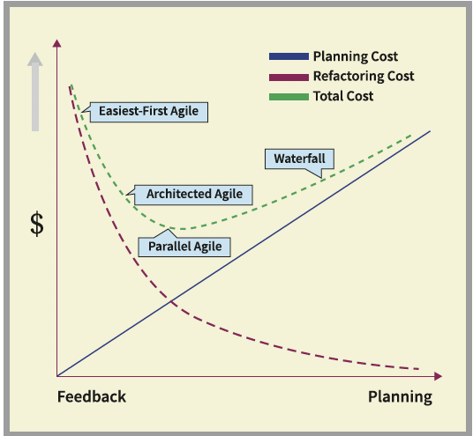
Parallel Agile balances feedback and planning
Too much planning and not enough feedback is expensive
Too much feedback and not enough planning is expensive
Agile Project Management
UML/Use Case Driven Design

Slide 4
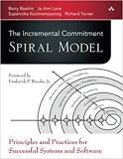
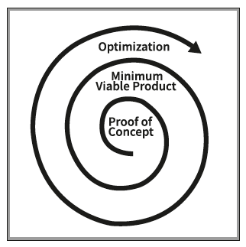
Spiral model lifecycle – 3 phases
Each phase has a sprint plan
API for database access generated early
Prototype first, then design carefully
Large teams can work in parallel
1 month per phase, can finish in 3 months
Multiple optimization sprints possible

Slide 5
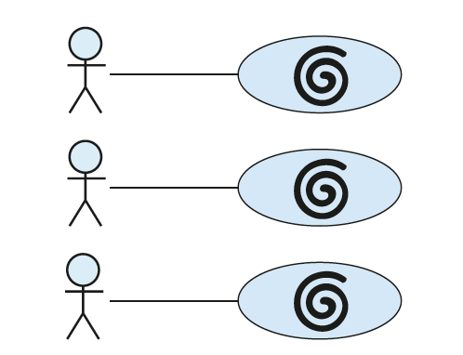
Use Case Driven Design
2014 – what if we applied the spiral model on a per use case basis?
Developers work in parallel
Each developer gets a use case
  Proof of concept (prototype)
  Minimum Viable Product (model-view-controller)
  Optimization (repeat as needed)

Slide 6
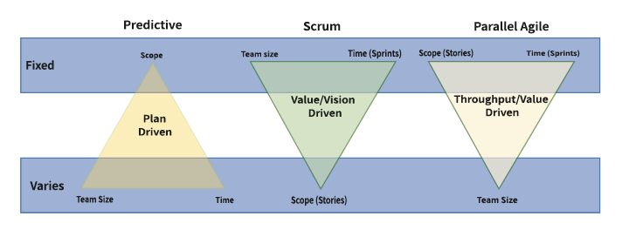
Large teams use Parallel Agile, small teams use Scrum
Chapter 5
Small team agile relies on “agile ceremonies” and sometimes skips design
Teams of any size can organize their work into user stories, tasks, and epics
Large team collaboration requires careful design

Slide 7
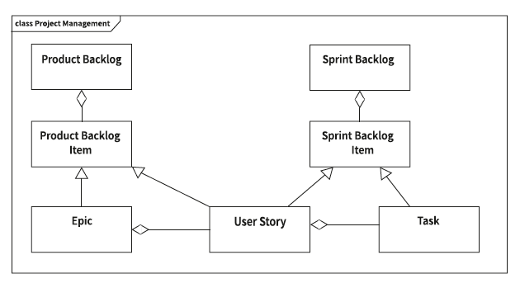
Small teams and short sprints use backlogs
Tasks and user stories migrate from the Product Backlog to the Sprint backlog and then move through stages of planning, coding and testing.

Slide 8
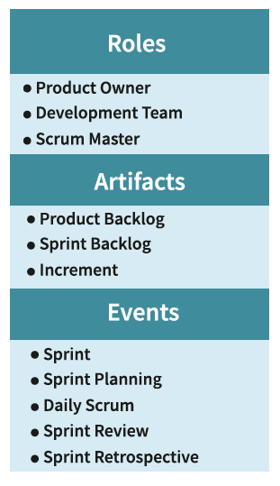
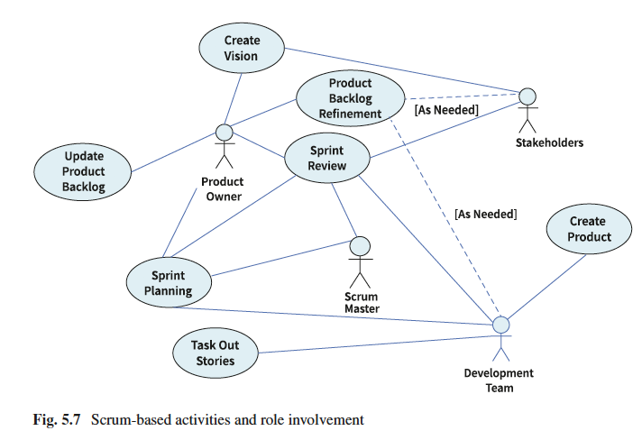
Scrum has an intricate series of management steps but does not dictate technical design
Parallel Agile simplifies management and puts more emphasis on modeling and design
PA also leverages code generation to shorten schedules

Slide 9
Sprint plans organize the work of a large team
UML Profile for Scrum
  User Stories and Tasks organized into Epics
Prioritizing work on EA Kanban Boards
Exporting user stories and tasks to Jira using ProCloud Server
Example: TikiMan Go Augmented Reality

Slide 10
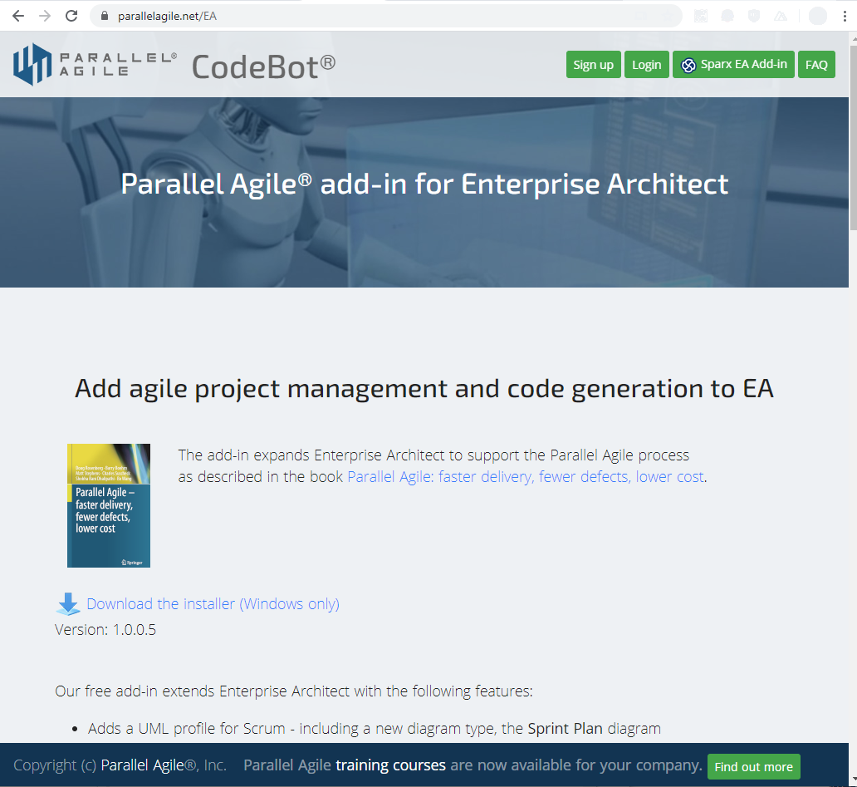
UML Profile included in Parallel Agile Add-In
Parallel Agile Add-In is free
Download from parallelagile.net/EA
Includes UML Profile for Scrum (sprint plan diagram)
Includes Use Case Complexity Analyzer
Integrates with CodeBot

Slide 11

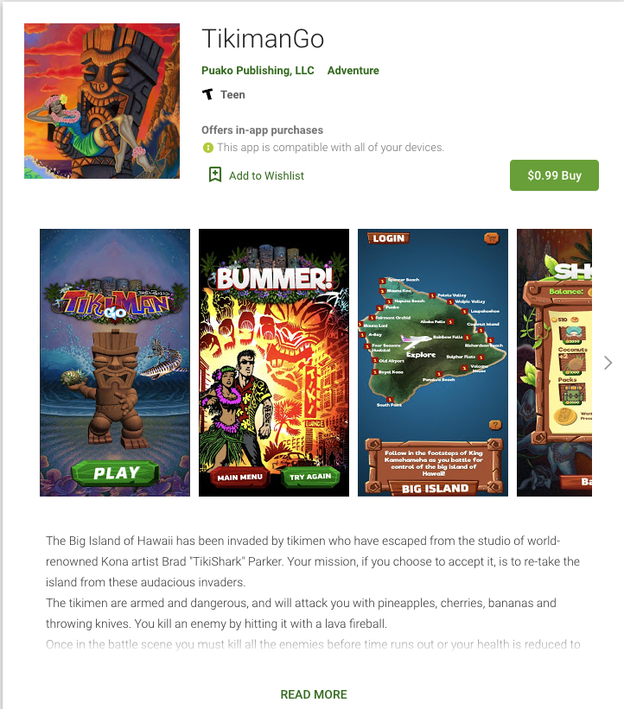
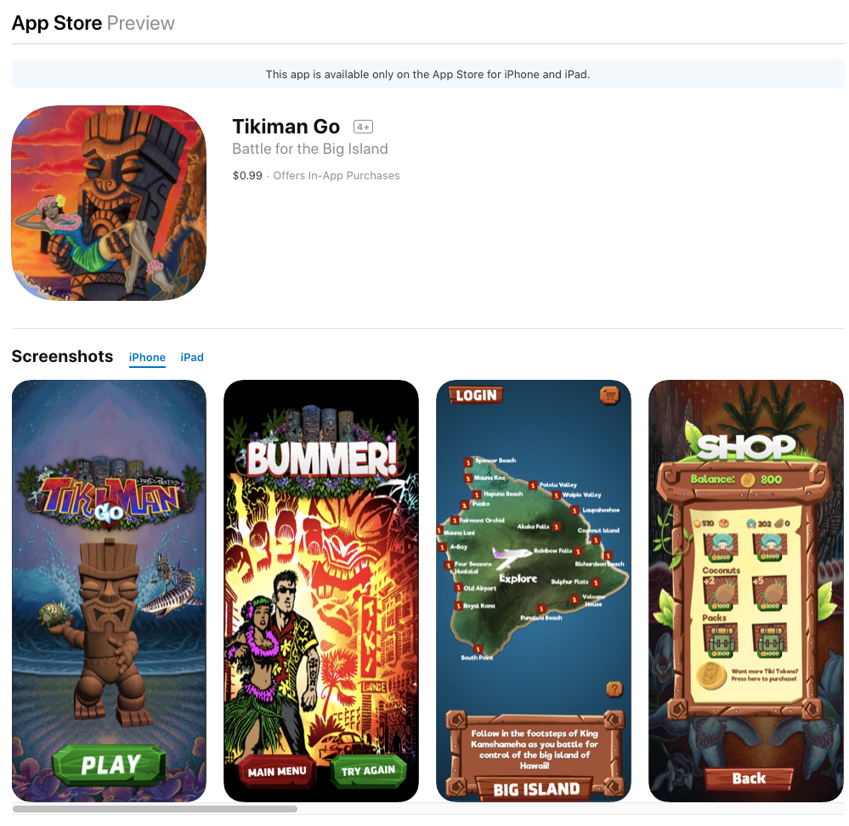
Example: TikiMan Go game
--- designed with Enterprise Architect
Test project for Parallel Agile
Hawaiian themed VR/AR game
Designed with Enterprise Architect
Use Cases, Domain Model, MVC
Unity 3D connected to Mongo DB via Node.js
Mongo/Node code generated from EA Domain Model
Recently published for Android and iOS
VR version published
AR version in development
Example is from currently ongoing development

Slide 12
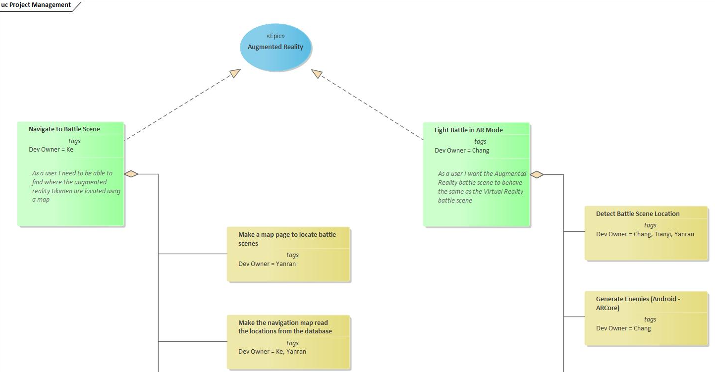
Sprint Plan
UML Profile for Scrum included in the Parallel Agile Add-In

Slide 13
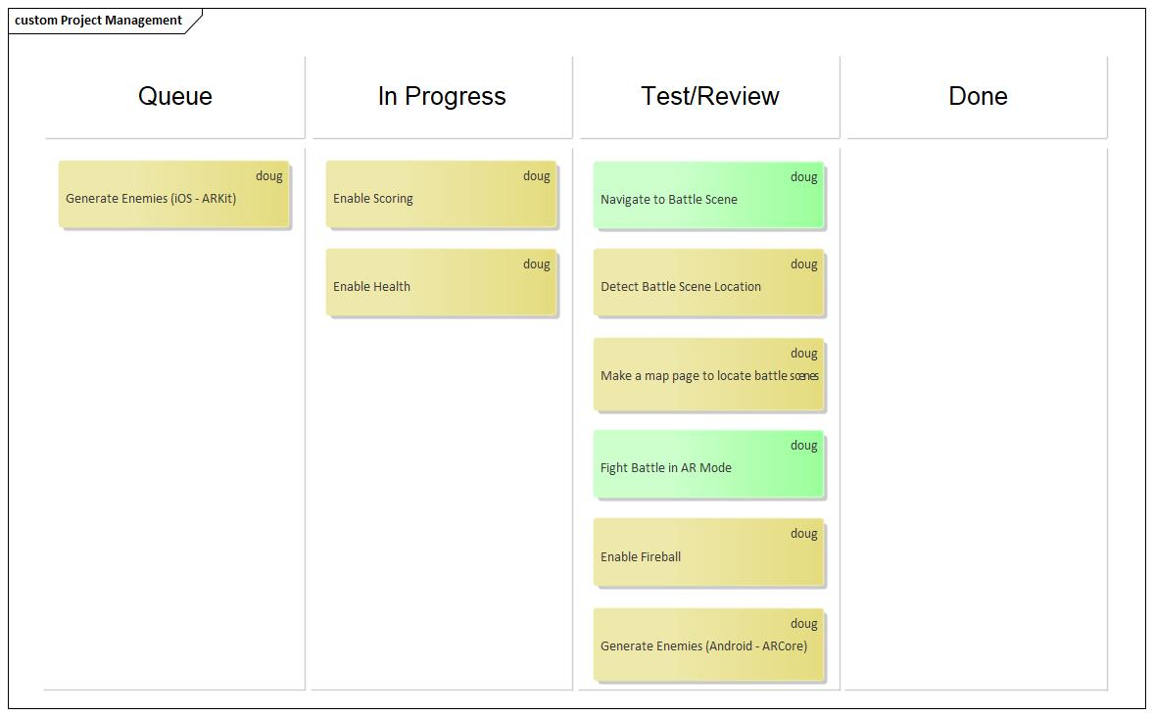
Kanban Board sequences tasks
Drag and drop user stories and tasks from EA Browser onto Kanban Board

Slide 14
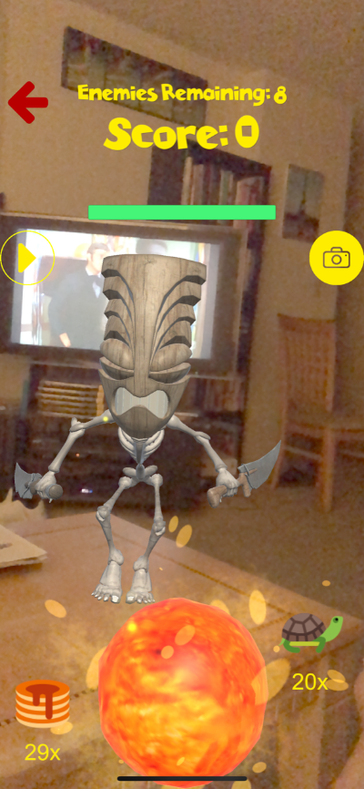
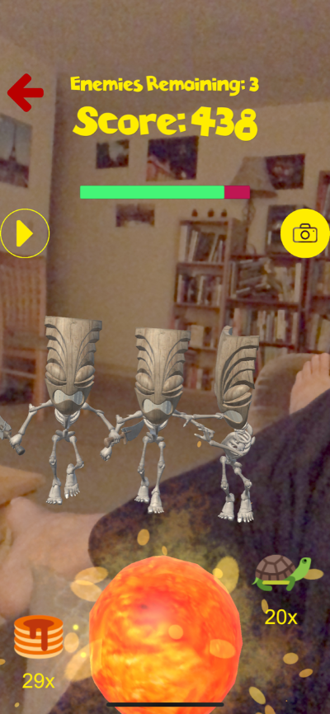
Fight Battle in AR mode
We’re currently developing an Augmented Reality version of the game

Slide 15
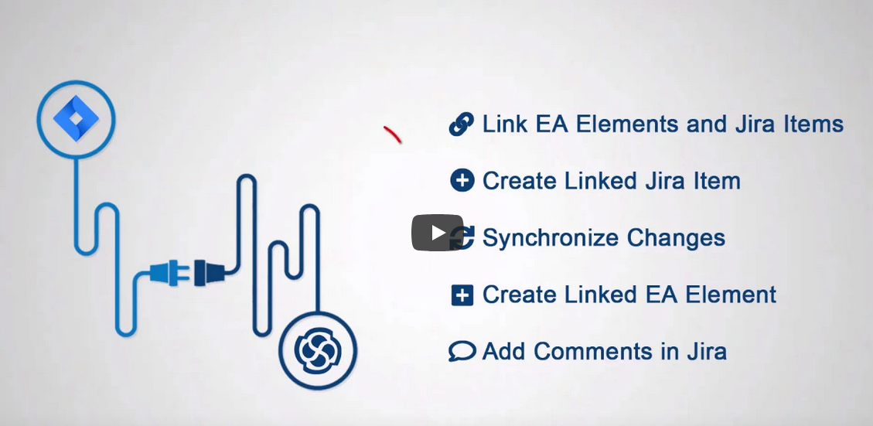
ProCloud Server interfaces to Jira
Thanks to Scott Hebbard of Sparx Systems for this section

Slide 16
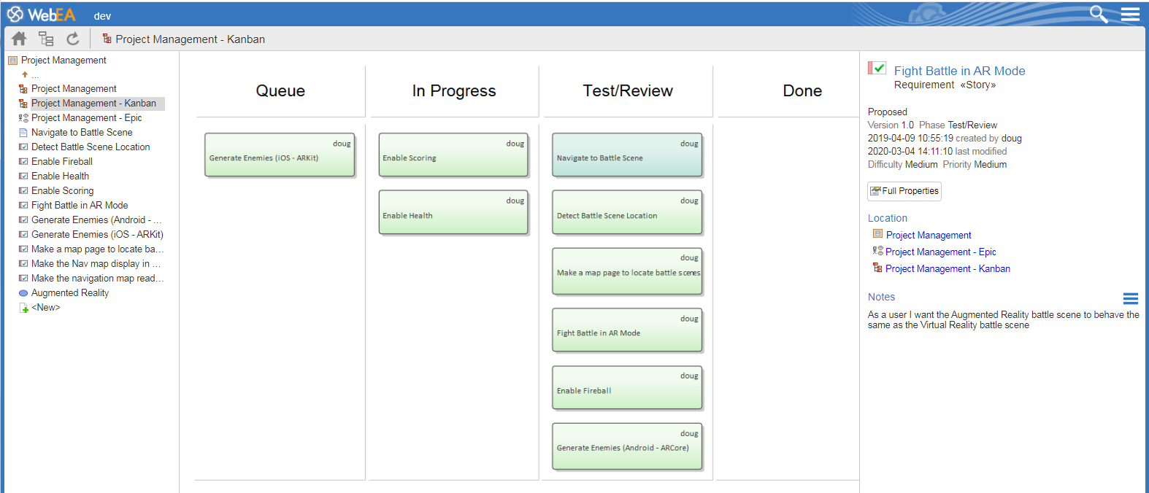
From EA to WebEA

Slide 17
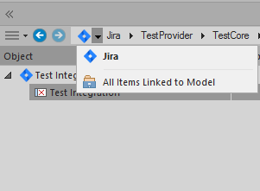
Linking to Jira is easy

Slide 18
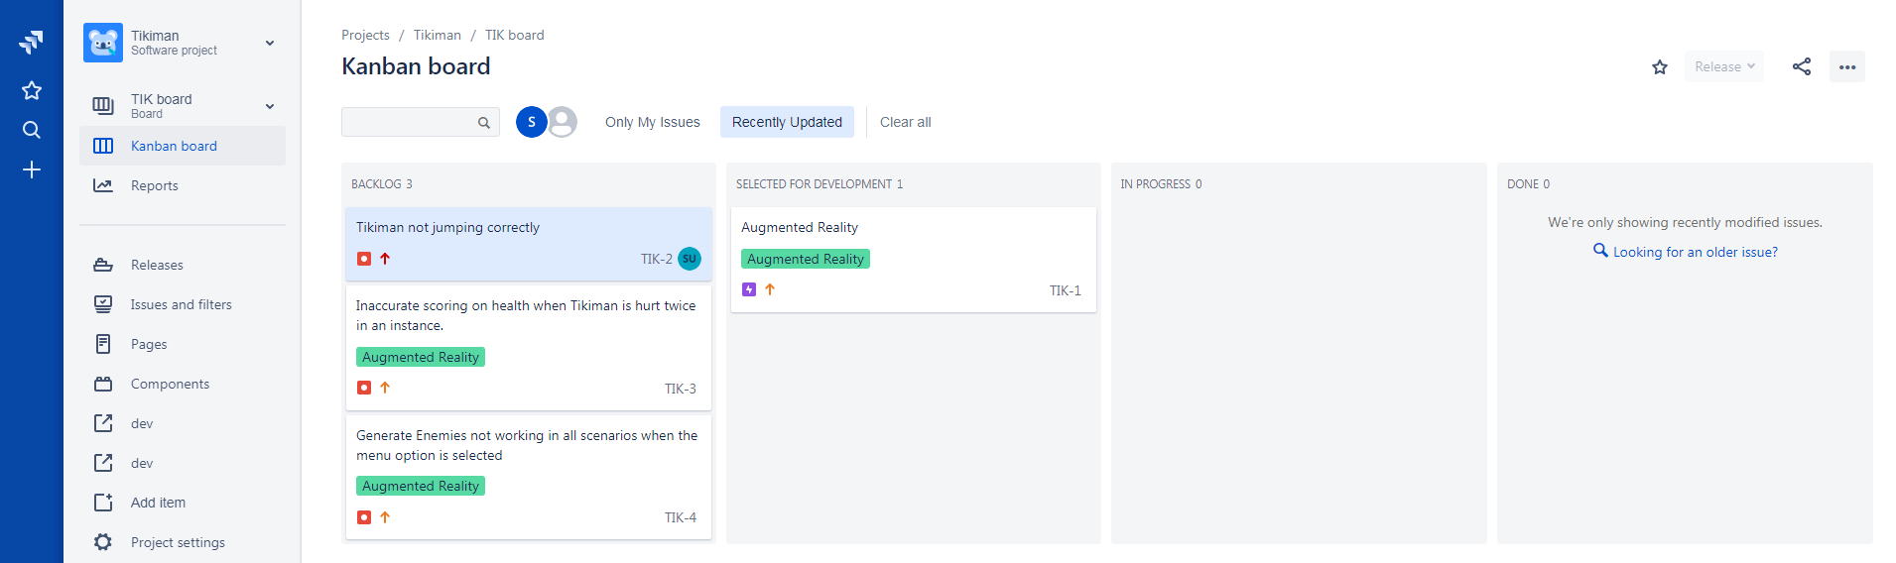
Add tickets in Jira (e.g. during testing)

Slide 19
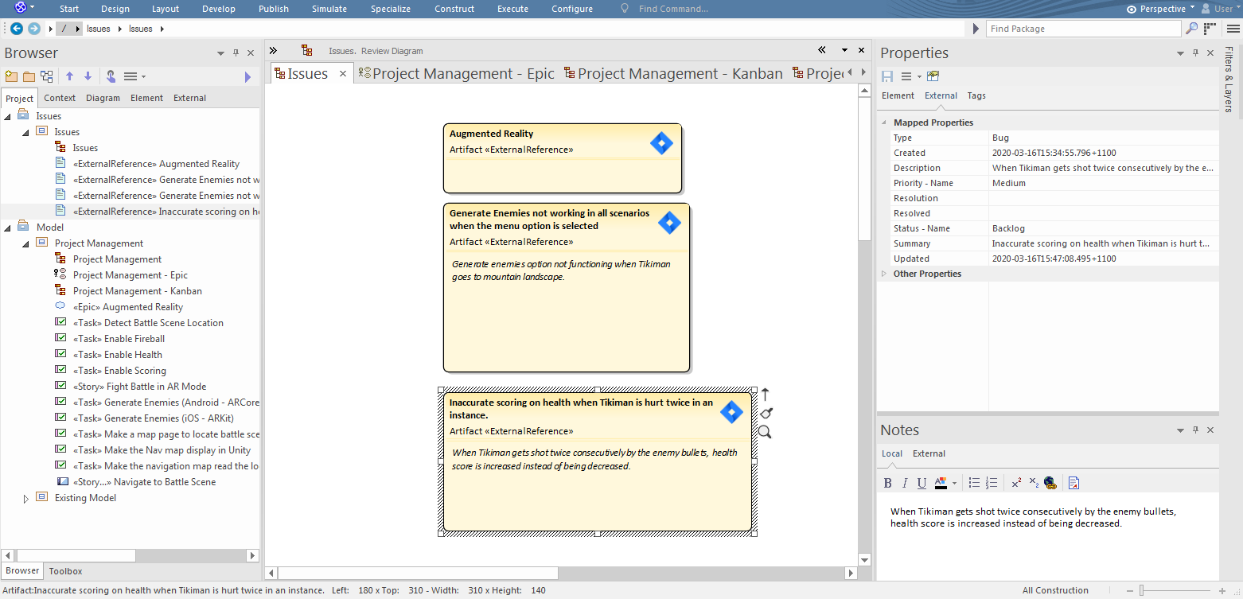
New tickets available in EA Model

Slide 20
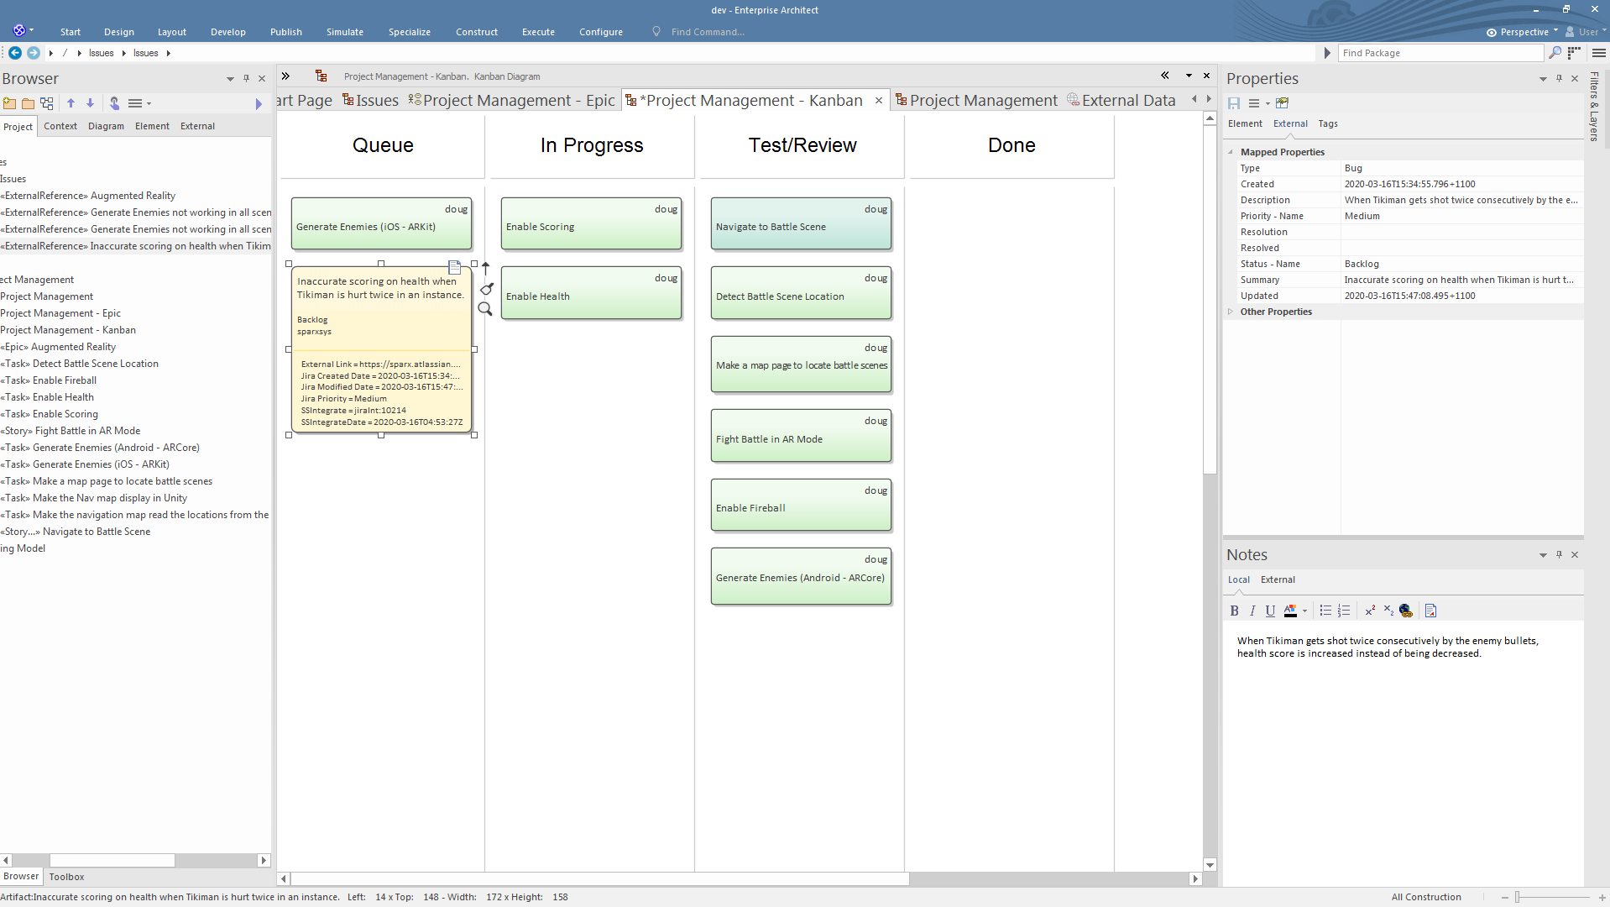
New tickets on Kanban board

Slide 21
Enterprise Architect covers technical and management aspects of a project
In this webinar we showed:
  How to use Enterprise Architect for Sprint Planning and to generate Jira tickets from your EA model
  Tomorrow’s session: CodeBot UX: Generate code from EA wireframes

Slide 22
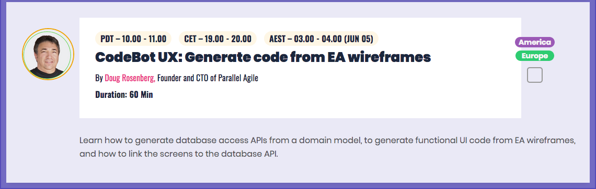
Thank you!
I’ll be back tomorrow to talk about CodeBot UX
Download the free Parallel Agile Add-In https://ParallelAgile.net/EA
Questions? doug@parallelagile.com

