Slide 1

A Deep Dive into Model
Add-ins

Slide 2
AGENDA
Automation in EA
Conventional Add-ins and its Complexities.
Introduction to Model Add-ins
Model Add-in Demonstration
Conclusion
1
2
3
4
5

Slide 3
Automation In EA
Automation
Enterprise Architect
Extending and Customizing the automation interface.
Enhances the core functionalities.
Manipulating the Repository Contents.
Integration with various products
Enabled through scripting environment or Traditional Add-ins.
Extensive Support for Customization

Slide 4
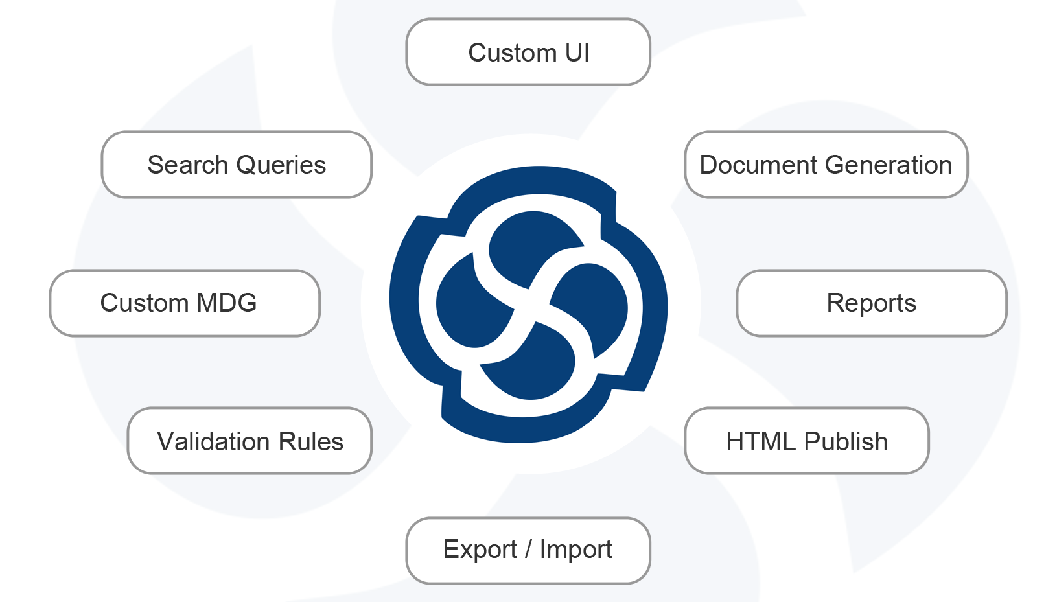
Frequent Customization

Slide 5

Conventional Add-ins
Support a wide range of programming languages.
Plenty of example projects available.
Available over a decade.
Adding customized functionalities to the core components were more obvious.
Prerequisites like IDE, COM Registration and Registry entries.

Slide 6
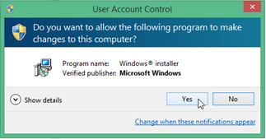
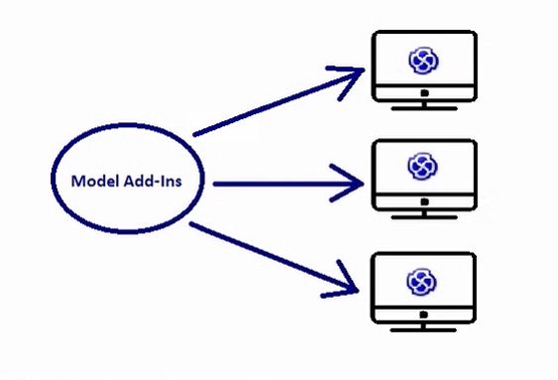

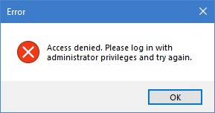
Complexities in Conventional Add-ins
Packaging
  Building the dll required after each changes in the Add-ins.
  An installer development effort is required to easily install an add-in
Distribution
  Distributing the add-in across the team is quite complicated.
  Approval might be required individually.
Deployment
  Required approval for installing the add-in in an organization.
  Deploying an add-in requires Admin privileges.
Build Dll
Create Installer
Packaging
Registry Entry

Slide 7
Complexity in Conventional Add-ins
Packaging
Distribution
Deployment
This process has to be repeated each time when an add-in is updated or required changes across the organization.

Slide 8
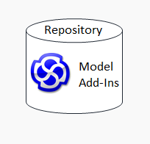
Model Add-ins
Model
Add-ins
Signal Reference Library
Attributes
Operations
Receptions
Recent Addition to Sparx features
No Installation, No Distribution or License Worries.
Specific to a Repository , everything is self-documented.
Built on a combination of Attribute, Operations, Receptions and Signal Reference Libraries.
Add-ins are Managed in Add-in Manager.

Slide 9
Signal Reference Libraries
Defines the Entry point to the add-in similar to COM classes in the traditional add-ins.
All the events are similar to the traditional add-ins. Receptions are similar to operations
Receptions is used to model the receipt of the signal.
Receptions cannot be created without signals.
Events required in the add-in should be added to the reception from the Signal Reference Library.
JavascriptAddin
(Entry Stereotype)
Reception
Receptions
Signal
Stereotype
(Events)
Model Add-Ins
Depends
Signal

Slide 10
Steps to build a sample model add-in

Slide 11
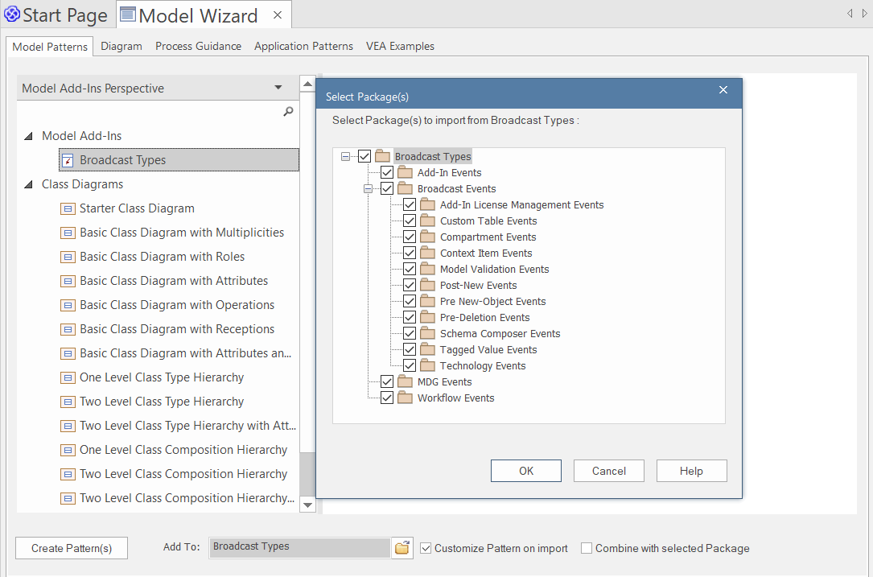
Step 1-Adding Events using model Wizard
Broadcast Types ( Events ) are sent to all the add-ins.
Can be added through Model Patterns.
Its mandatory to have these events in the model for building Model Add-ins.
All these Events are Signal type.

Slide 12
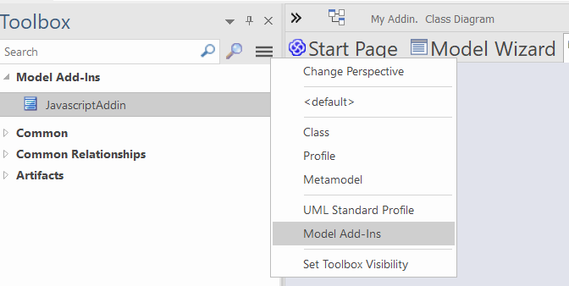
Step 2-Adding entry element from toolbox
Add an element with stereotype ‘JavascriptAddin’
This stereotyped element will be an entry point to the model add-in.
All the codes , events related to the model add-ins should be added in this element.

Slide 13
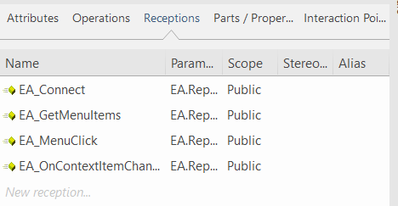
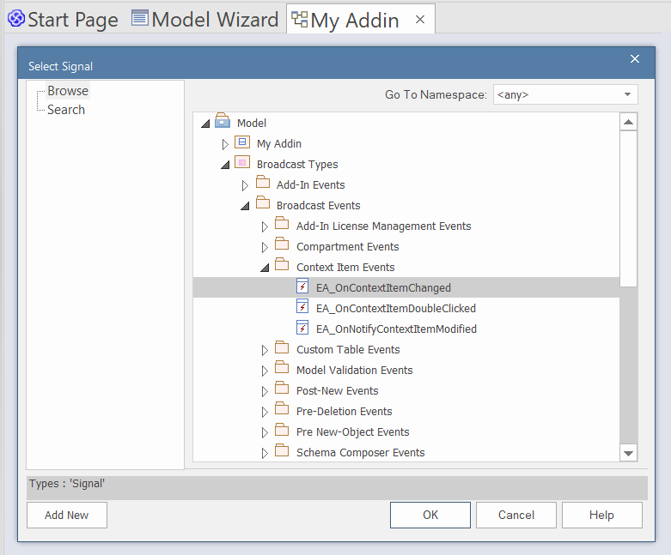
Step 3-Adding receptions
Receptions should be added to the ‘JavascriptAddin’.
Can be found in an feature similar to operations.
Required signals (broadcast events) should be added to the reception.
Events EA_Connect, EA_GetMenuItems, EA_MenuClick are
indispensable.
Events added in the reception will be triggered in the model add-ins.

Slide 14
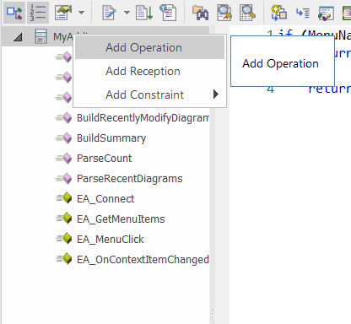
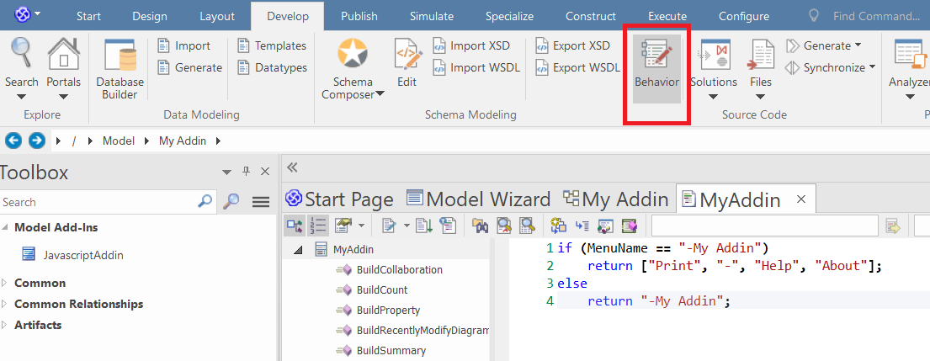
Step 4 – Behavior Code Editor
Source code editor can be opened through behavior.
Editor also includes some features of major IDE like Macros, line number, Intelli-sense, Syntax highlighting, shortcut keys, etc.
All the added receptions ( events ), operations and attributes will be displayed in the left pane in the tree structure.
Each item in the tree can be selected and code can be entered in the right pane.

Slide 15
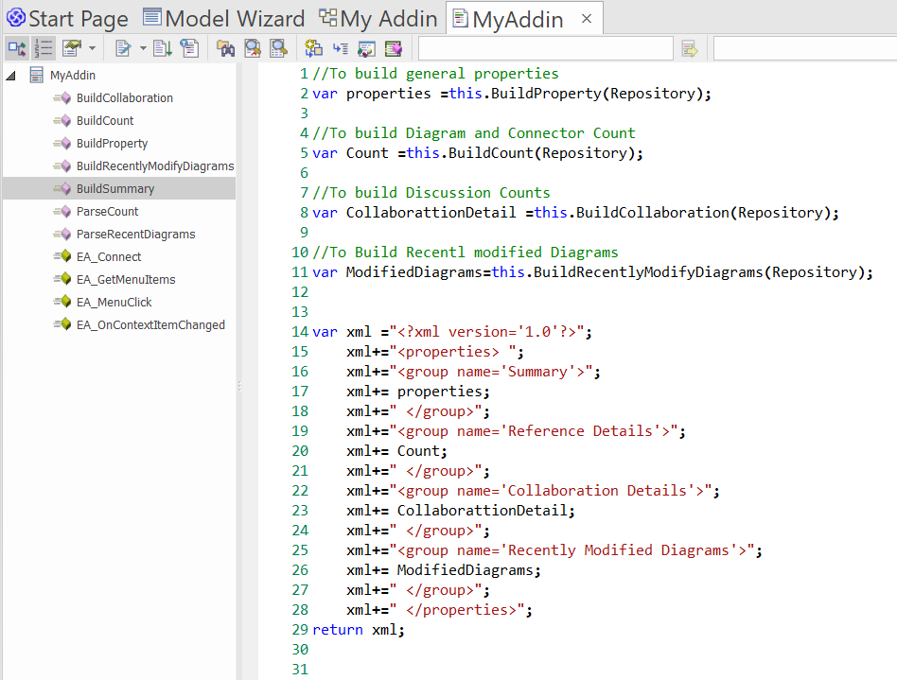
Step 4 - Code Editor
An illustration of the add-in program which contains operations, receptions and attributes in an editor related the to model add-in.

Slide 16
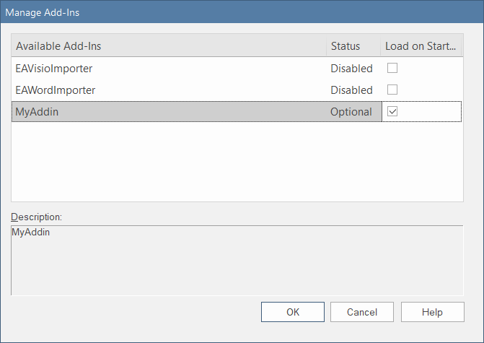
Step 5 –Manage Add-ins
Similar to conventional add-ins, model add-ins are also managed in Manage Add-Ins.
All the model add-ins will have the status as “Optional”.
Disabling and enabling the add-in can be used to refresh or reload the model add-ins in a repository.

Slide 17
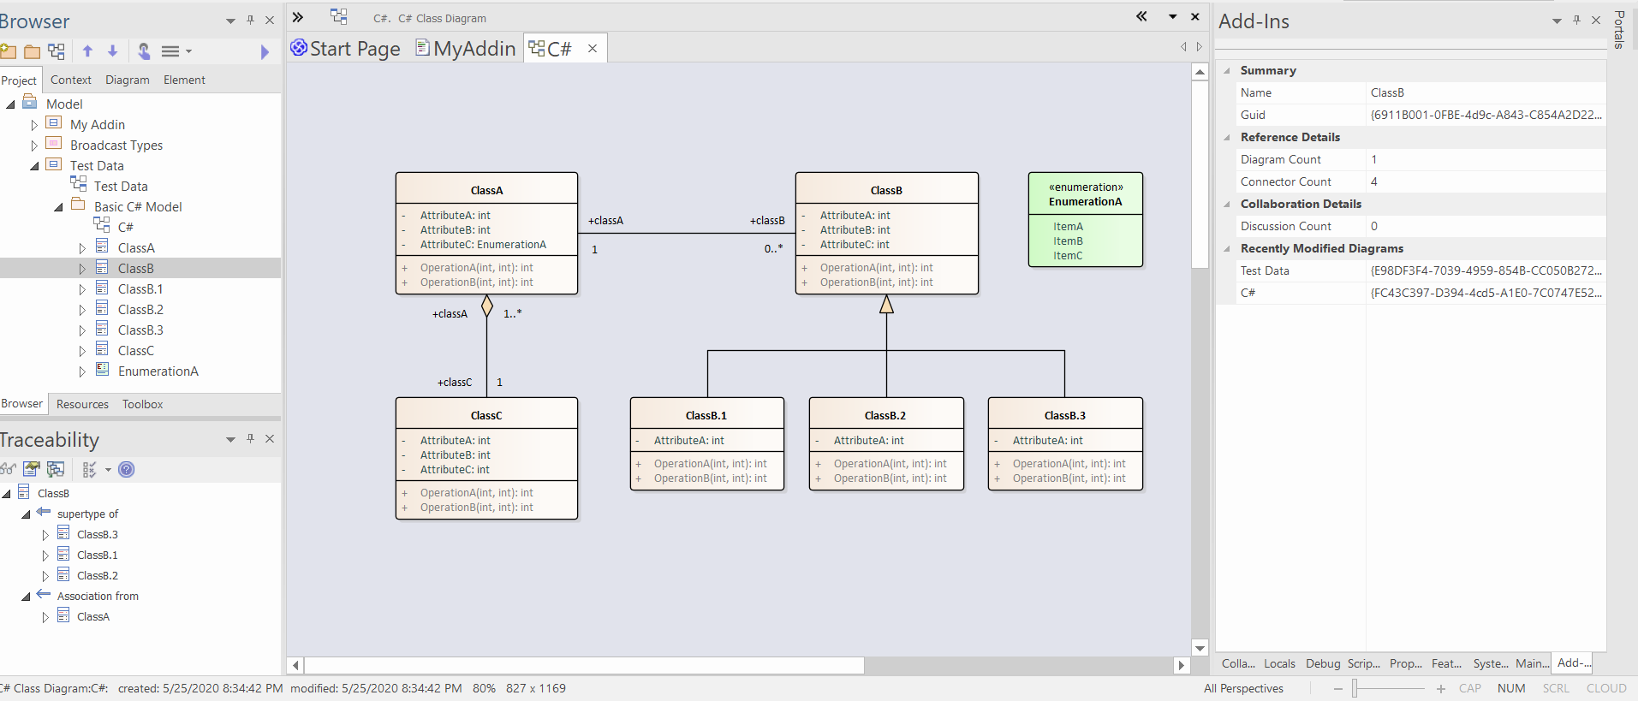
Sample Add-in Demonstration
Build a Hello World model add-in.
Add the required broadcast events.
Create an entry element and add the required Operations, Attributes, and receptions to that element.
Design a dockable window to display basic properties, counts of the diagram, connector, and discussions along with a group of top 5 recently modified diagrams.

Slide 18
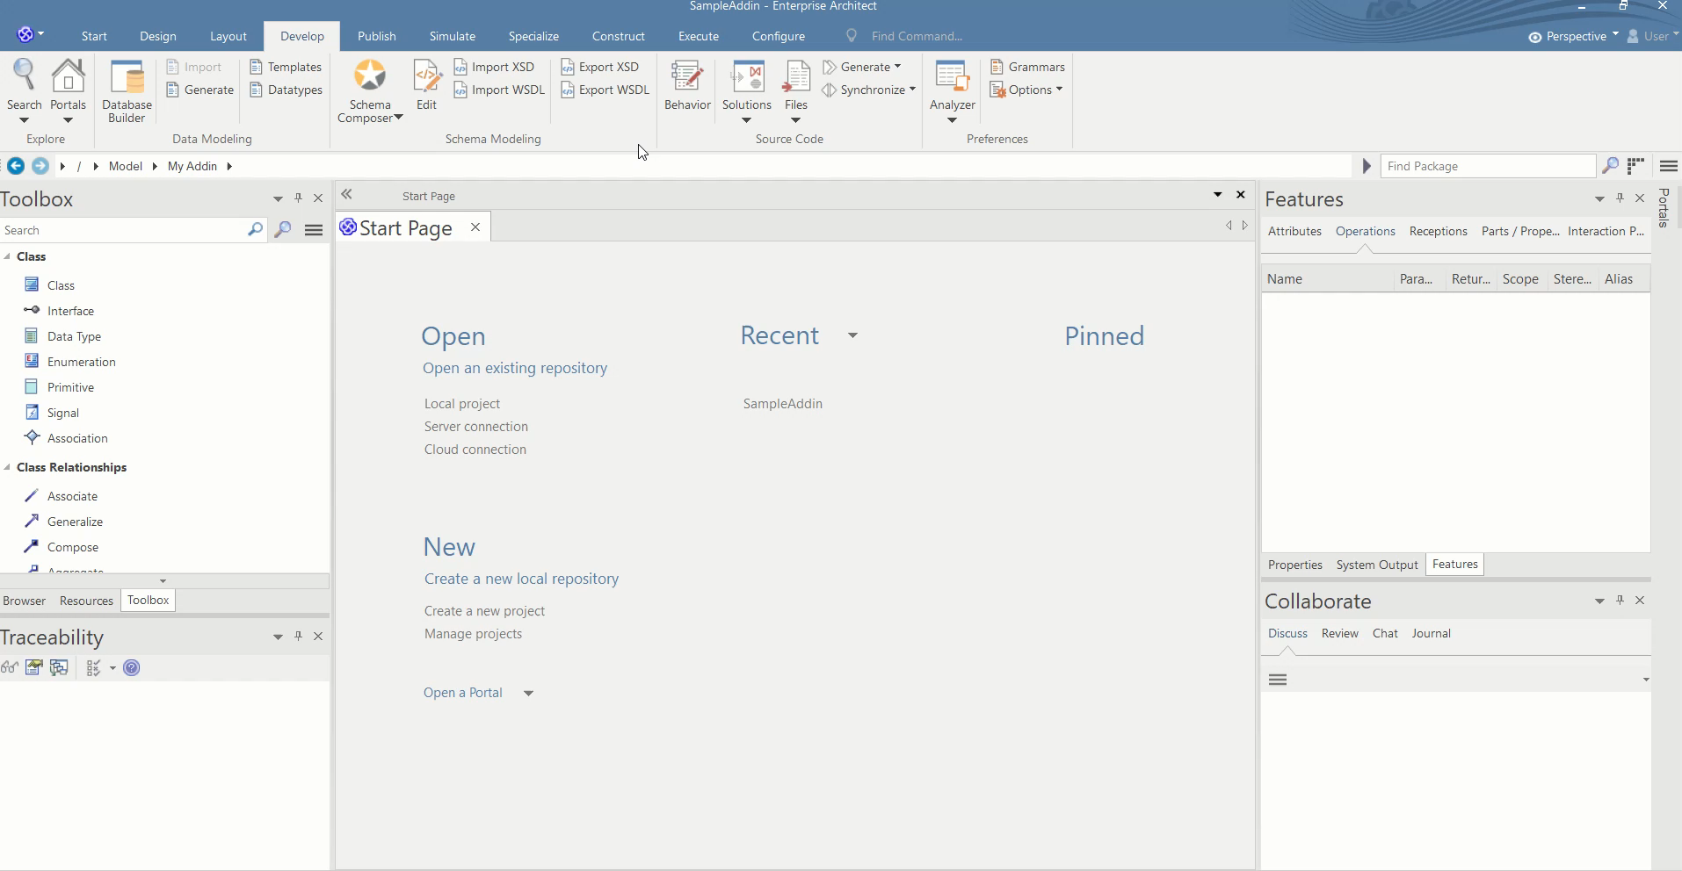

Slide 19

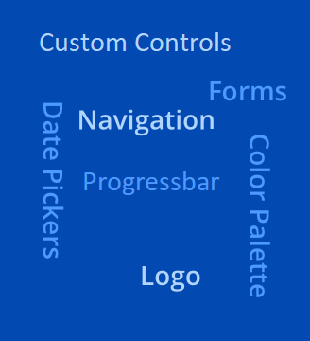


LIMITATIONs of Model Add-ins
Model Add-Ins
Repository 1
Repository 3
Repository 2
Only Supports JavaScript’s.
Designing Complex UI or Forms is not supported as in traditional Add-ins.
Breakpoint Debugging is complicated in the code editor.
Sharing Add-ins across different Repositories requires additional efforts.

Slide 20
Conclusion
Easy Deployable
Distribution across repository users made simpler.
Model Specific.
Self Documented.
No prerequisites or dependencies for development.
Inexpressive User Interface.

Slide 21

Thanks for your attention
contact:
Sparx Systems India, info@sparxsystems.in
Or visit
www.sparxsystems.in

